Slide 1
scRNAseq Results
Differentiation from DSCs to Melanocytes

Slide 2
00-ScaleRNA pipeline

Slide 3
ScaleRNA pipeline
Fastq files from 5 runs were labelled according to the run
All 480 fastq files were processed simultaneously with the ScaleRNA nextflow pipeline (https://github.com/ScaleBio/ScaleRna)
A detailed summary of the pipeline is shown on the next slides

Slide 4
ScaleRNA pipeline
Single-cell RNA sequencing libraries were prepared using the ScaleBio platform and sequenced across five independent Illumina runs. Raw sequencing data were obtained in the form of paired-end FASTQ files, with each run designated by the suffix “run1.fastq.gz”, “run2.fastq.gz”, and so forth. All FASTQ files corresponding to the same library were provided as input to the ScaleRNA analysis pipeline (v2.0.1; ScaleBio, https://github.com/ScaleBio/ScaleRna), which internally resolves sample multiplexing and performs barcode demultiplexing based on kit-specific sample barcodes.
Demultiplexed reads were subsequently merged across sequencing runs, resulting in 18 distinct biological samples for downstream analysis. Adapter trimming was performed using cutadapt, with adapter sequences and trimming parameters specified according to the manufacturer's recommendations in the library structure files. Quality control metrics for the raw and trimmed reads were assessed with FastQC.
Alignment of reads was carried out using STARsolo (Dobin et al., 2013) against the GRCh38 reference genome, employing the default settings for strand specificity and multimapping. Unique molecular identifiers (UMIs) and cell barcodes were extracted according to the ScaleBio kit design. PCR duplicates were collapsed, and gene-level count matrices were generated for each sample. The resulting .bam files were saved for later RNA velocity analyses by specifying the bamOut = TRUE option in the runParams.yml.
Cell calling and filtering were performed using the ScaleRNA pipeline's default CellFinder algorithm, which combines data-driven thresholding and statistical rescue of barcodes with expression profiles deviating from ambient RNA. Only barcodes passing the cell calling thresholds were used for analysis.
All computational analyses were conducted in a reproducible environment using Docker containerization. Gene-by-cell count matrices produced by the pipeline were used for all subsequent analyses. Gene-by-cell count matrices generated by the ScaleRNA pipeline were imported into R (v4.5.1) and analyzed using the Seurat package (v5.3.0).

Slide 5
01-Doublet detection

Slide 6
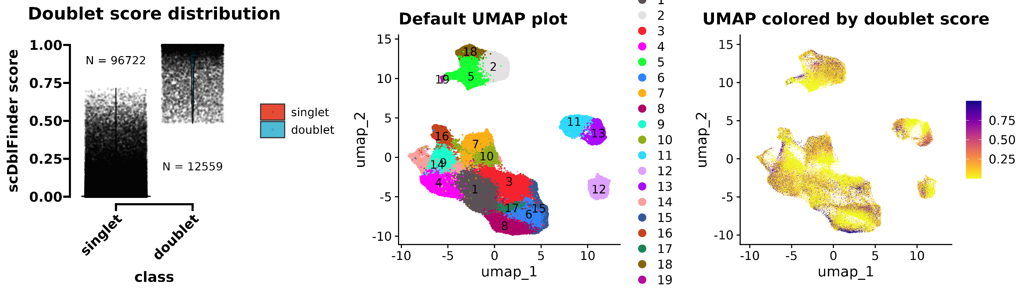
Doublet detection
Doublet identification was done with scDblFinder at Default settings for each sample separately
https://pmc.ncbi.nlm.nih.gov/articles/PMC9204188/
Settings for UMAP: 30 PCA dims to find neighbors, cluster resolution of 0.8

Slide 7
02-Data processing

Slide 8
Data processing
Removal of doublets
Calculation of QC metrics
Novelty score (log10(genes)/log10(counts))
Ratio of mitochondrial RNA

Slide 9
03-Quality control

Slide 10
Quality control
Quality control metrics were evaluated for all samples following initial cell calling and matrix generation using the ScaleRNA pipeline. For each sample, we assessed the total number of cells identified after demultiplexing and cell calling. For each cell, we examined the number of unique molecular identifiers (UMIs), the number of detected genes, the novelty score (log10 of the number of genes per UMI), and the proportion of reads mapping to mitochondrial genes.
Cells exhibiting >10% mitochondrial RNA content were excluded form downstream analyses, consistent with established best practices for scRNAseq. No additional filtering of cells was performed on the basis of these metrics, as all samples exhibited robust quality profiles and the distributions of UMIs (min: 703), gene counts (min: 447) and novelty scores ratios (min: 0.817) were consistent with expectations for high-quality single-cell RNA-seq data as outlined here: https://www.embopress.org/doi/full/10.15252/msb.20188746.

Slide 11
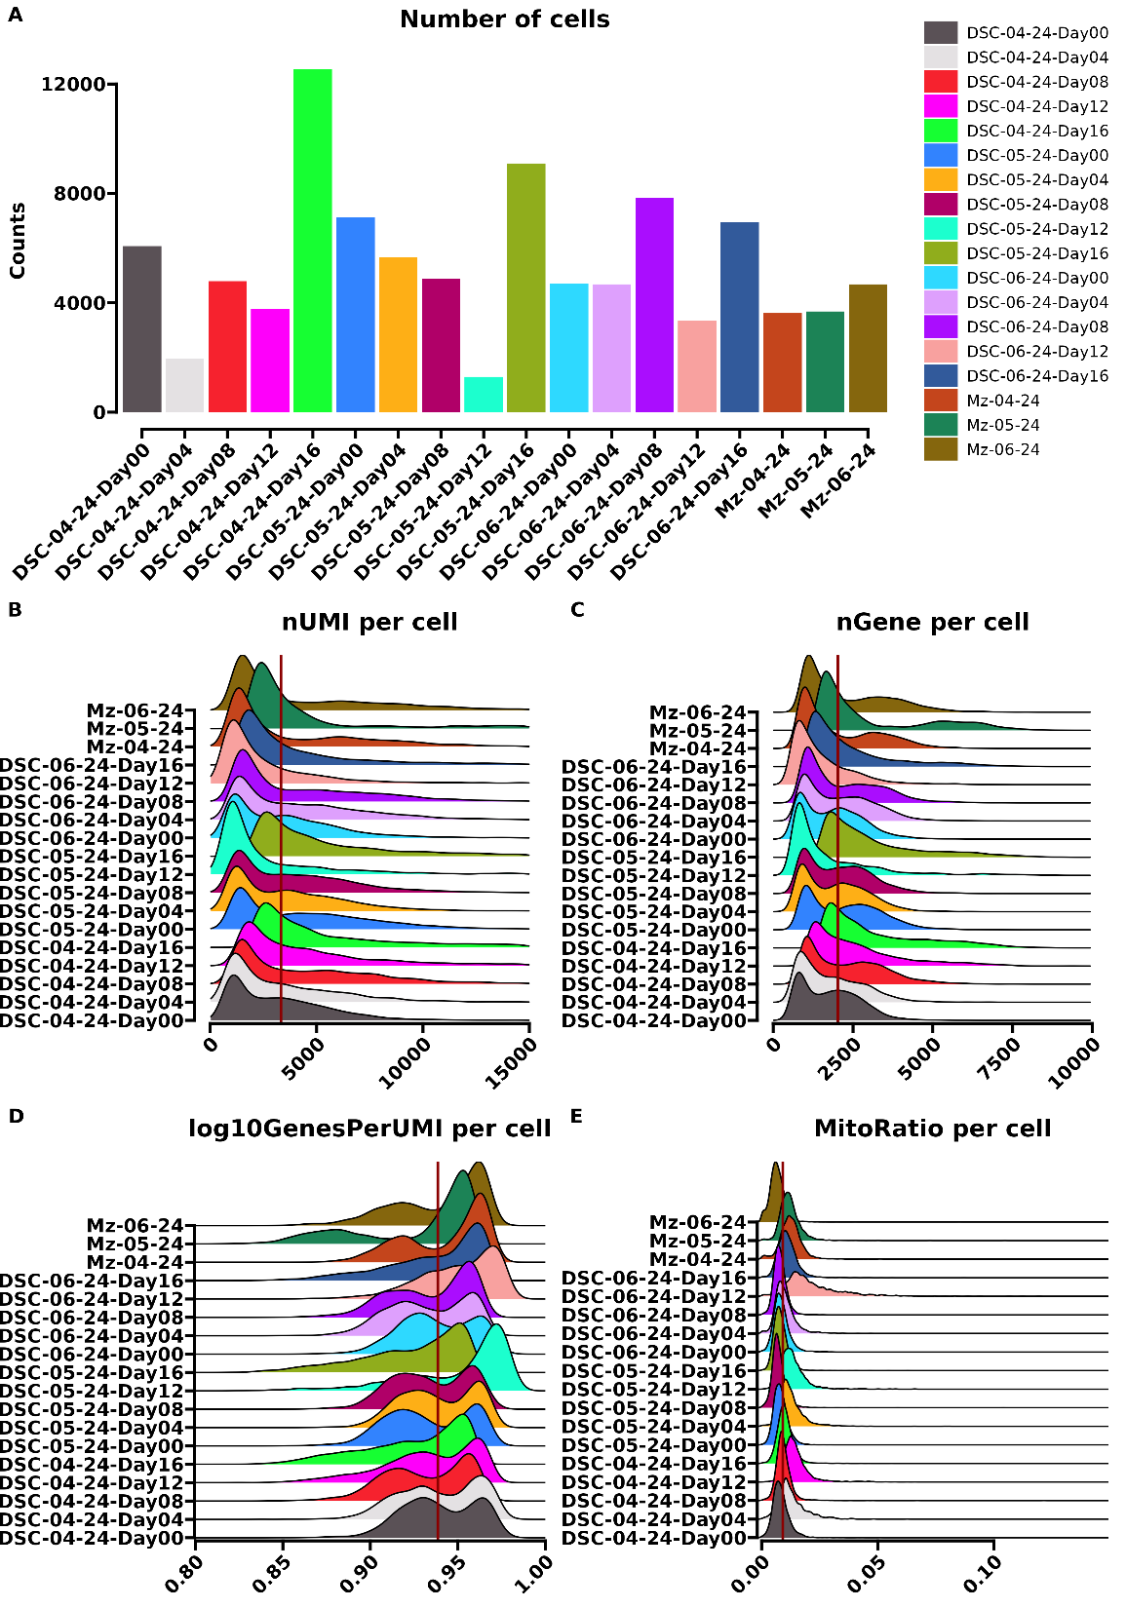
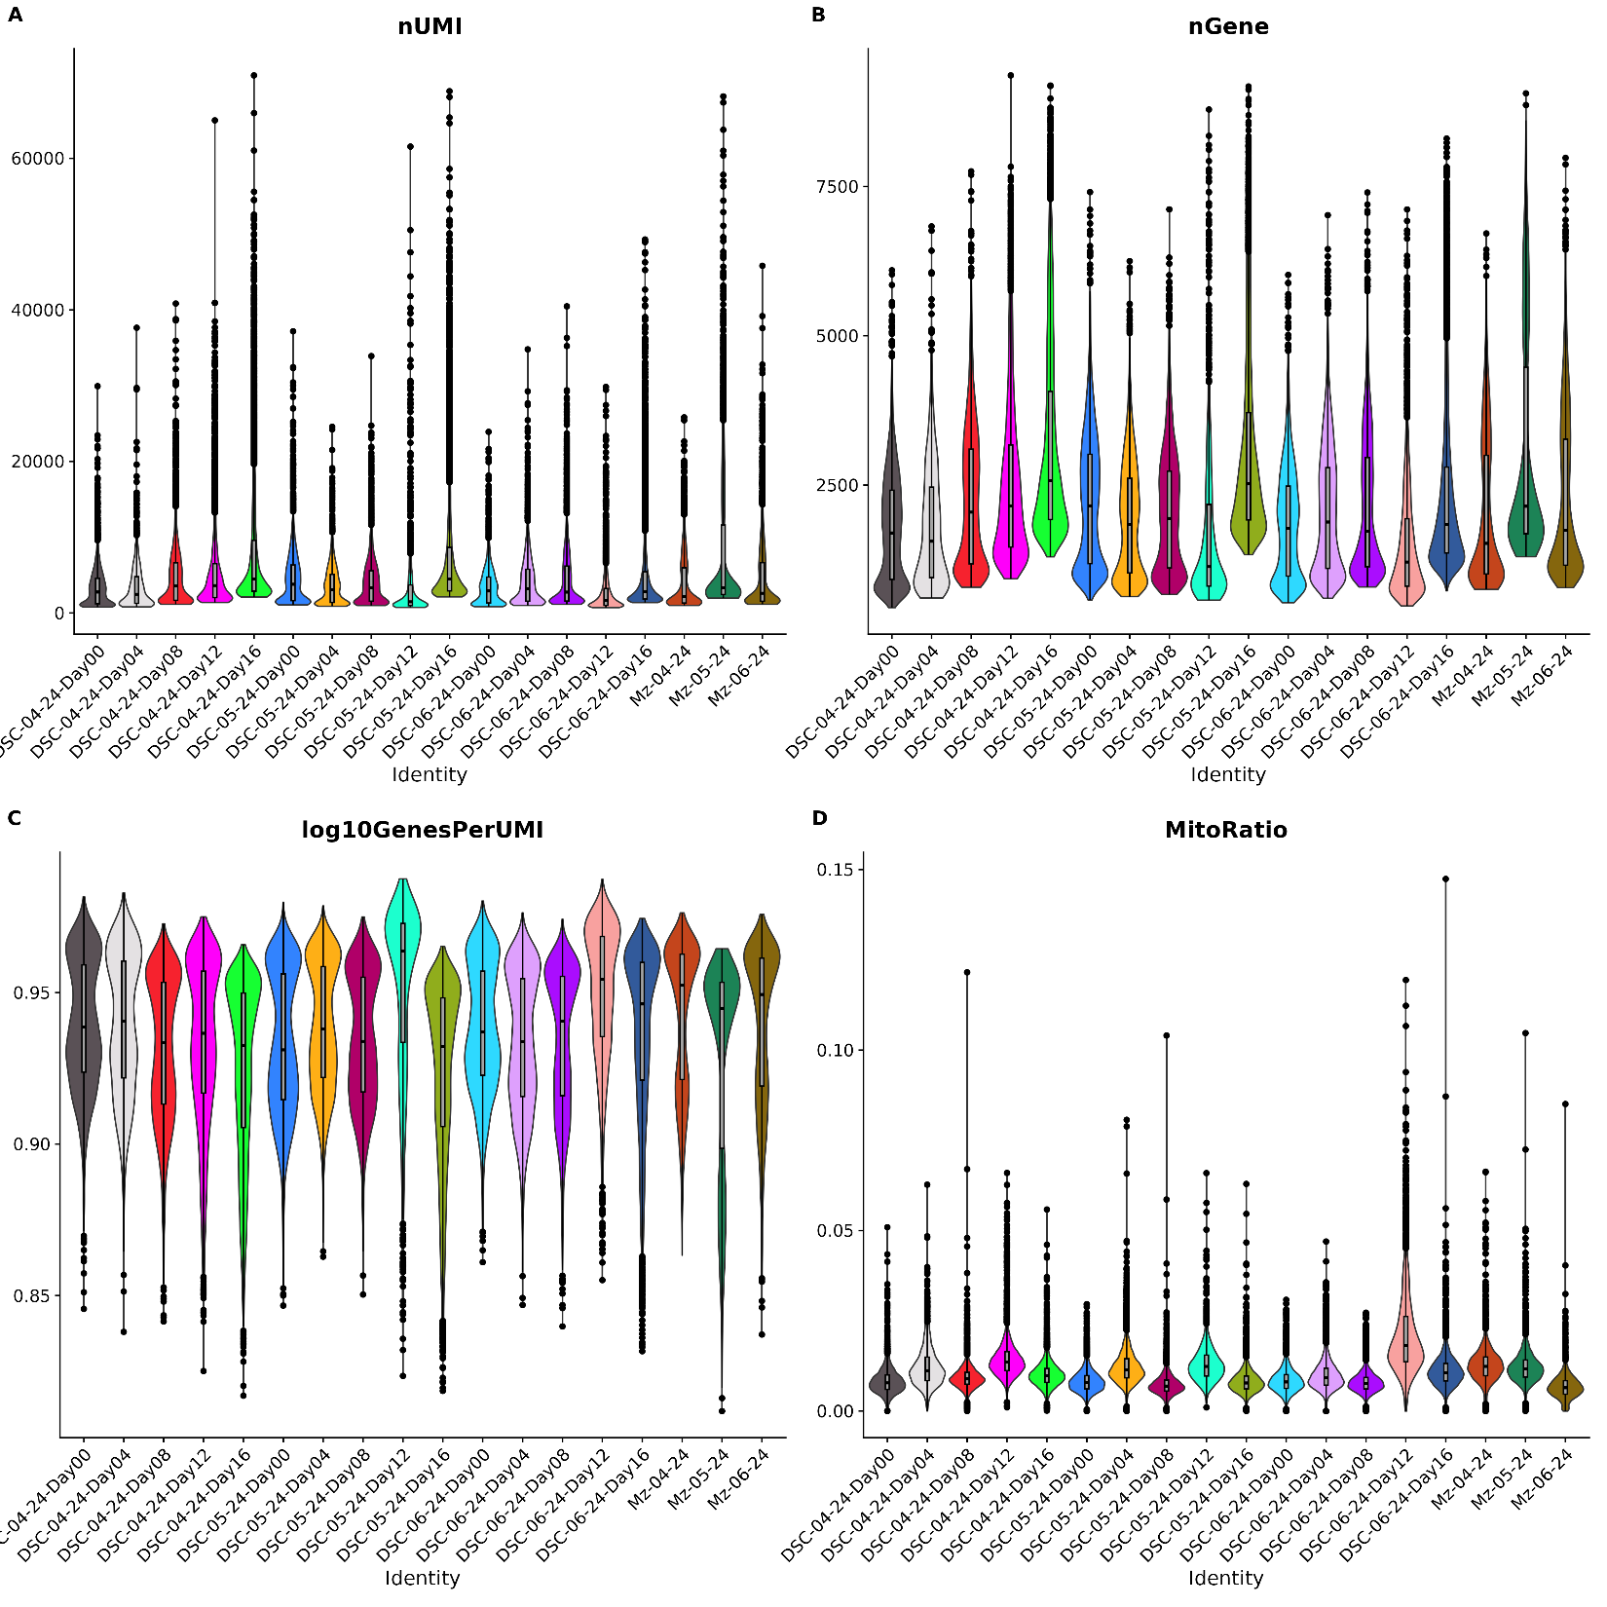

Slide 12
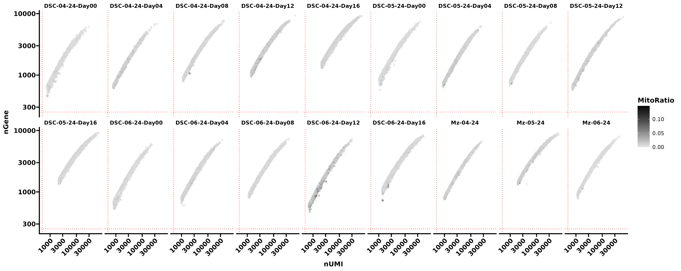
Red dotted lines depict a 500 UMI count and 250 gene count threshold

Slide 13
04-Normalization

Slide 14
Normalization
Normalization was performed using Seurat’s NormalizeData() function with the default “LogNormalize” method, as recommended in recent benchmarking (Huber 2023), which demonstrated that simple log-normalization outperforms more complex approaches across diverse single-cell RNA-seq datasets. Following best practices (https://pubmed.ncbi.nlm.nih.gov/31178118/), matrices were split by sample, and normalization was carried out independently for each sample layer.
To assess the influence of cell cycle variation, we applied Seurat’s CellCycleScoring() function, utilizing the canonical S-phase and G2/M-phase marker gene sets from the Seurat package (cc.genes). Highly variable genes were identified using FindVariableFeatures() with the “vst” method and a selection of 2,000 features. Data were scaled with ScaleData() prior to principal component analysis (PCA) and dimensionality reduction. Nearest-neighbour graphs were constructed using the first 30 principal components, and clustering was performed with the Leiden algorithm at a resolution of 0.8 (FindClusters()). Two-dimensional embeddings were generated with UMAP (RunUMAP()) using the same principal components.
Initial UMAP visualization revealed a pronounced effect of cell cycle phase on transcriptomic variation. To mitigate this, we repeated normalization and scaling, regressing out the S-phase and G2/M-phase scores (as computed by CellCycleScoring()) using the vars.to.regress parameter in ScaleData(), following the recommendations in the Seurat vignette (https://pubmed.ncbi.nlm.nih.gov/31178118/). This adjustment minimized cell cycle-associated heterogeneity in downstream analyses. Other commonly regressed out covariates (e.g. mtRNA content) were not removed due decreased cluster accuracy (Germain et. Al 2020)
Huber 2023: https://www.nature.com/articles/s41592-023-01814-1
Germain 2020: https://genomebiology.biomedcentral.com/articles/10.1186/s13059-020-02136-7

Slide 15
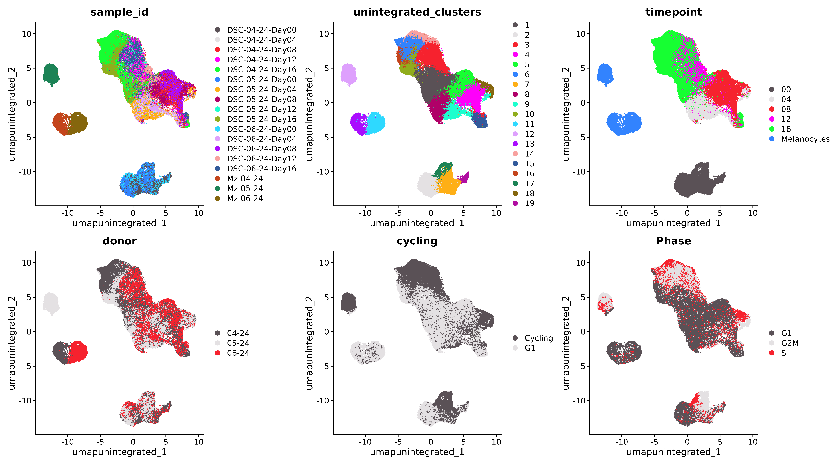
UMAP before adjusting for cell cycle effect

Slide 16
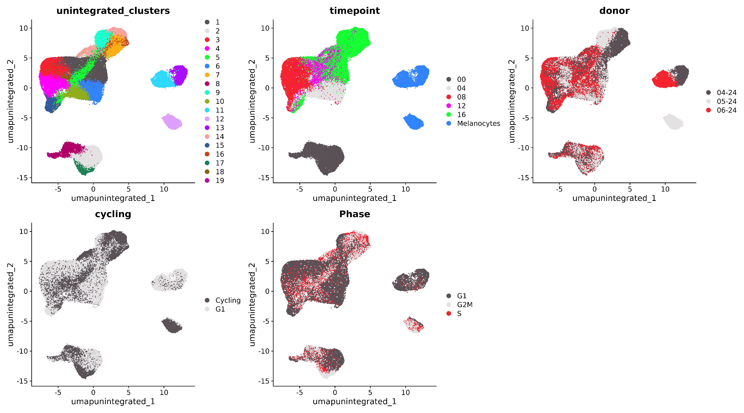
UMAP after adjusting for cell cycle effect

Slide 17
05-Dimensionality reduction and integration

Slide 18
Dimensionality reduction
Following cell cycle correction, the resulting Seurat objects were further processed with principal component analysis (RunPCA), neighbour graph construction (FindNeighbors), clustering (FindClusters, resolution = 0.6, Leiden algorithm, refinement of cluster resolutions), and UMAP visualization. To account for batch effects and facilitate data integration across samples, we applied two state-of-the-art algorithms using the IntegrateLayers framework: Harmony and scVI.
Harmony offers rapid and robust batch correction within the PCA space, requiring minimal parameter tuning and yielding interpretable results, but may be limited in handling highly non-linear batch effects (Luecken 2022). In contrast, scVI employs deep generative modelling to capture complex, non-linear sources of variation and provides uncertainty estimates, though it is computationally intensive and requires a dedicated Python (conda) environment. Integration was followed by dimensionality reduction, neighbour graph construction, clustering, and UMAP visualization using the respective integrated embeddings.
Luecken, M.D. et al. Benchmarking atlas-level data integration in single-cell genomics. Nature Methods 19, 41–50 (2022).

Slide 19
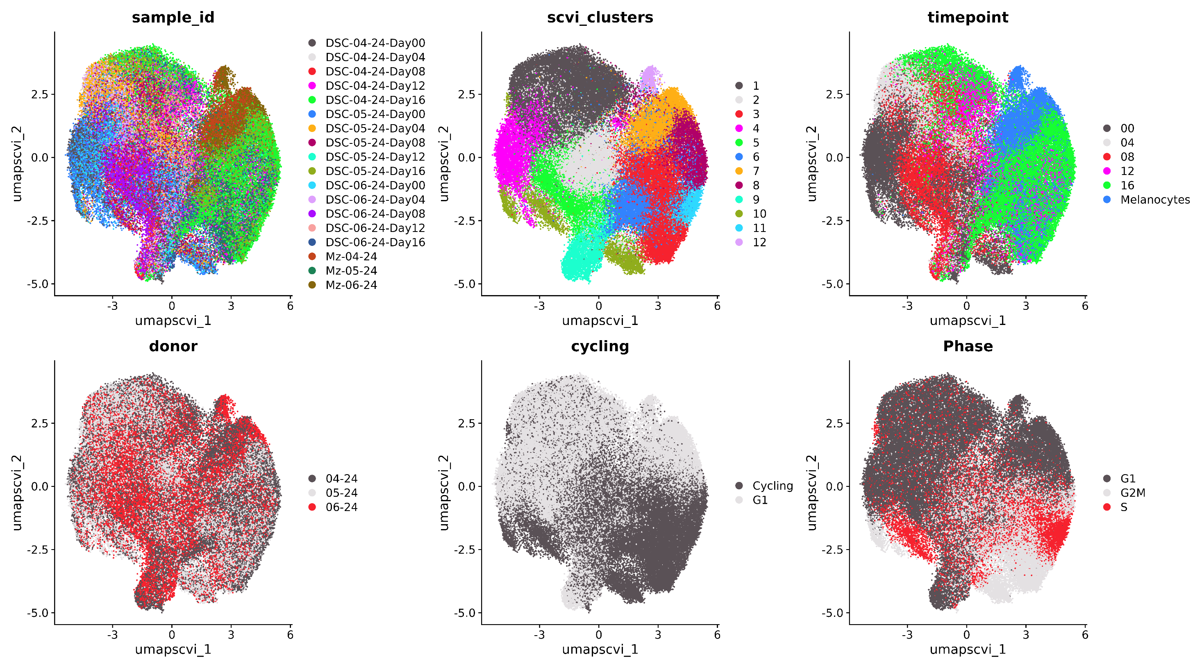

Slide 20
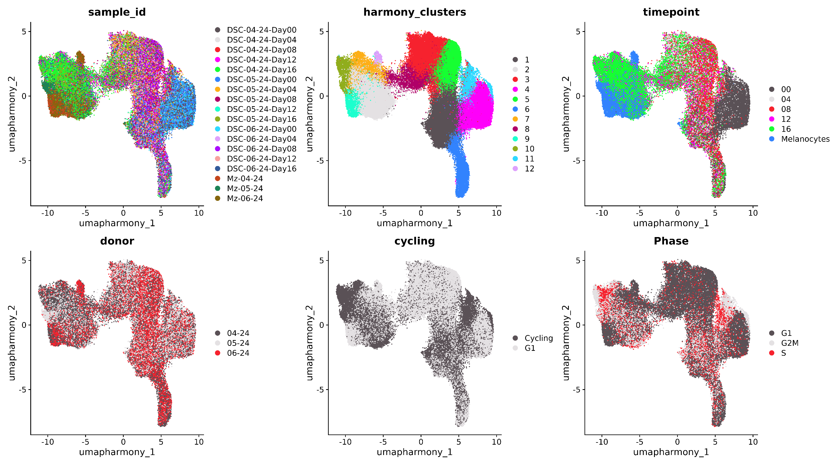

Slide 21
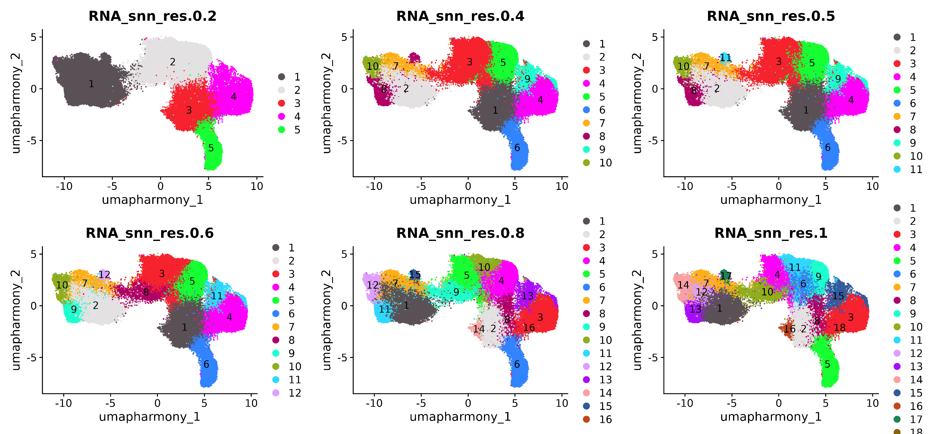
Comparison of cluster resolutions

Slide 22
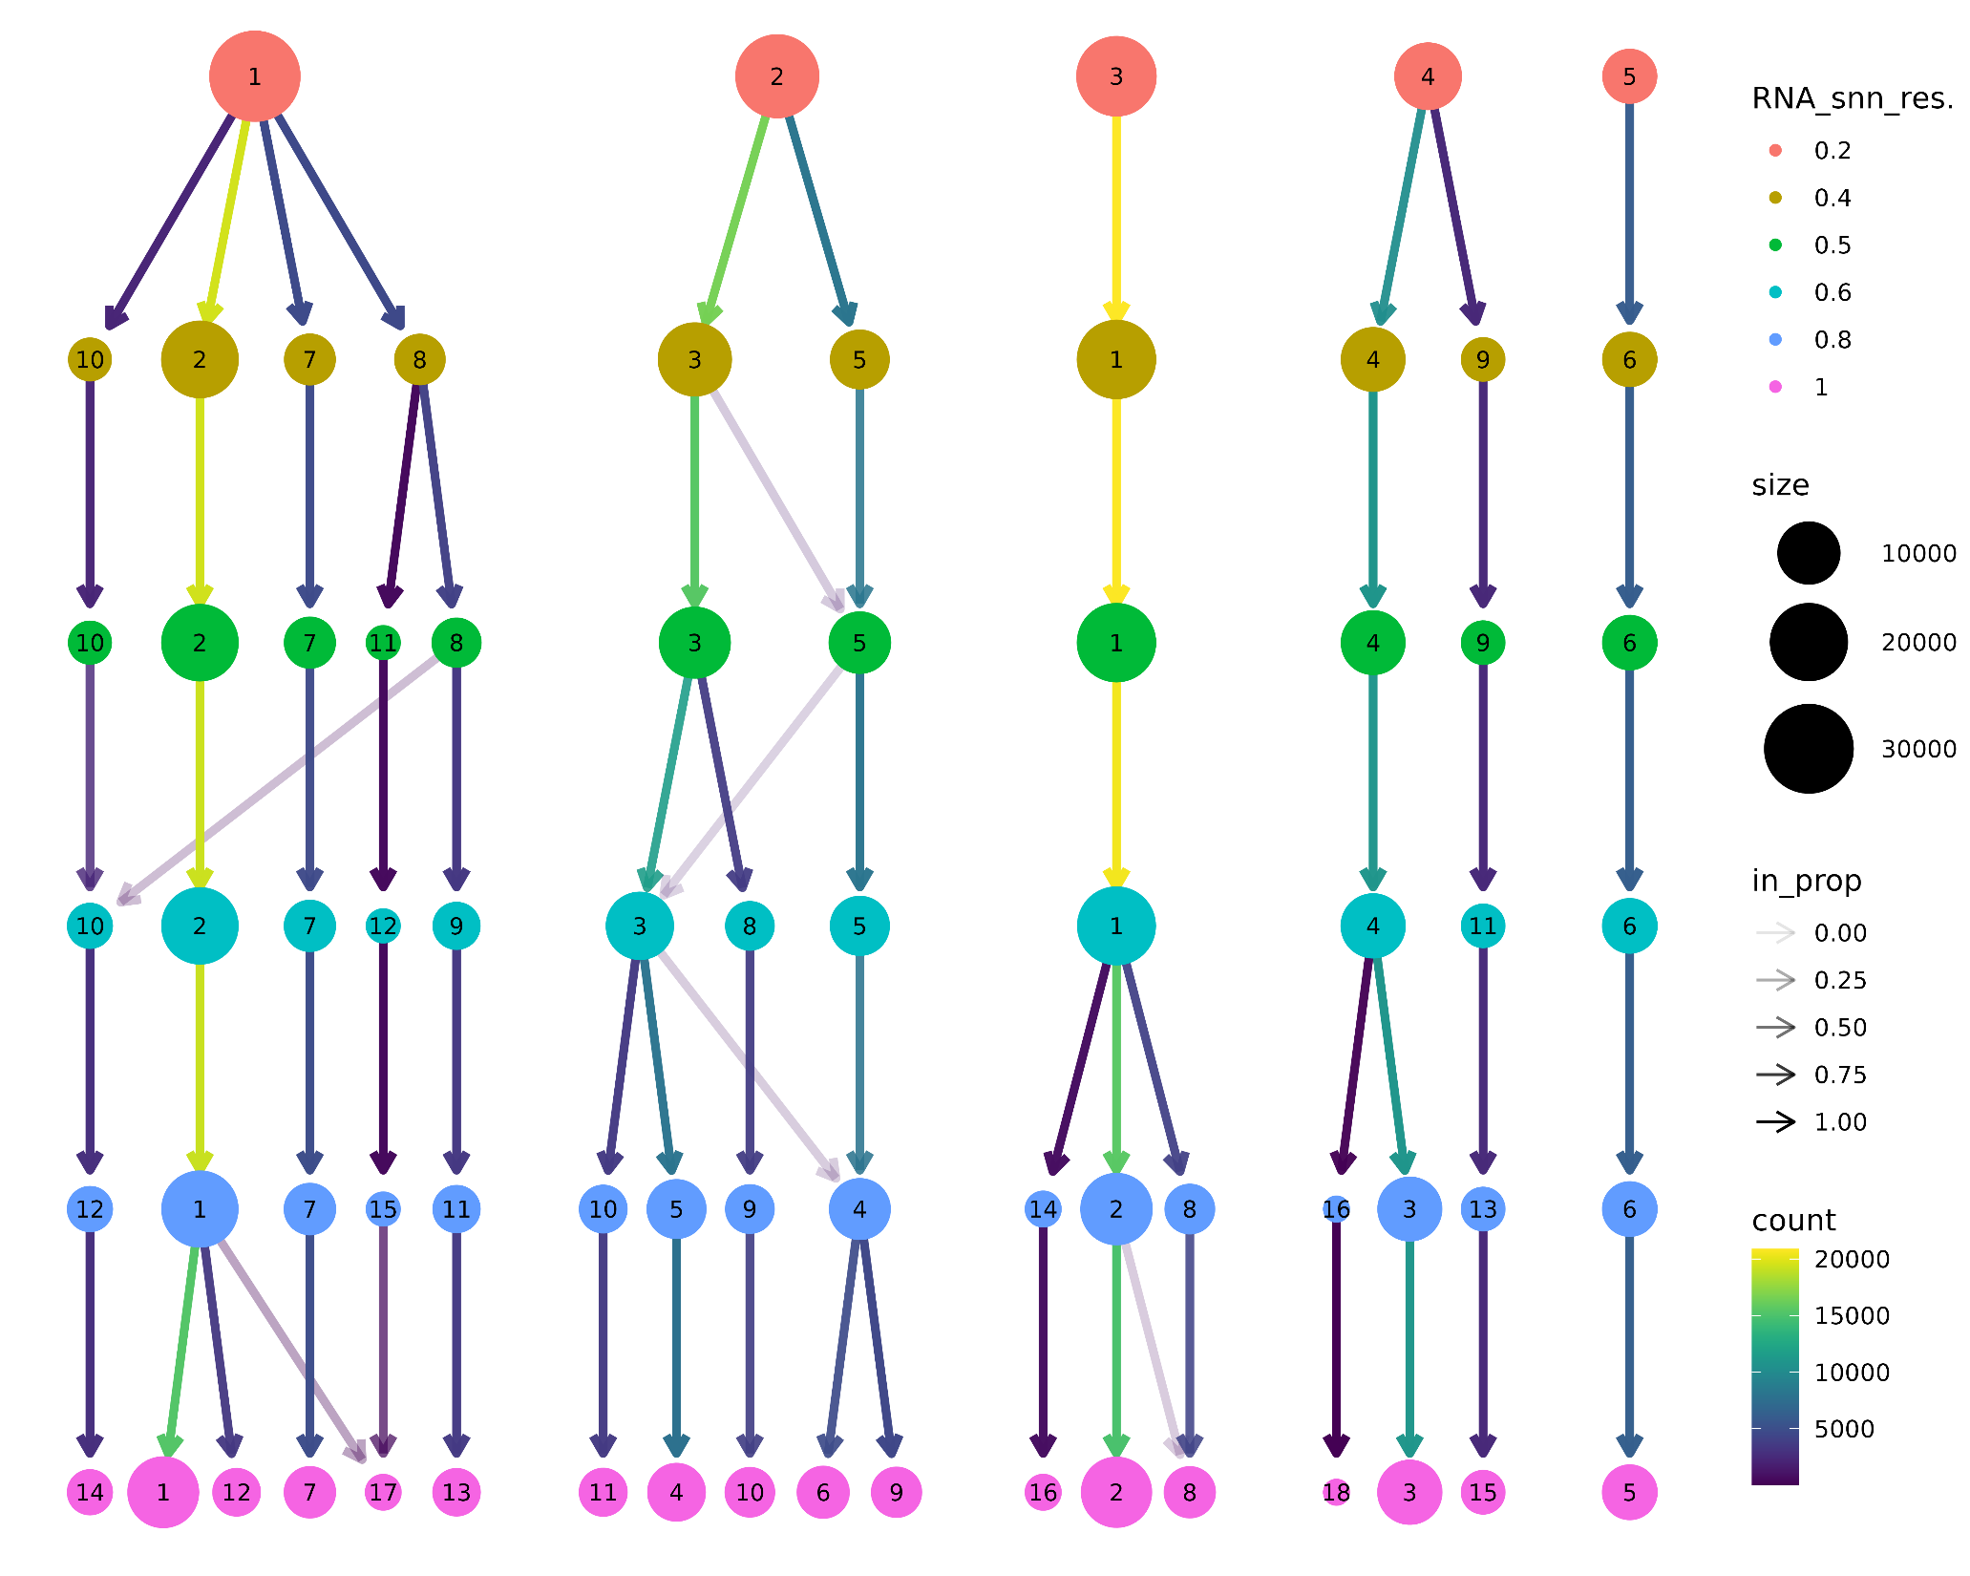
Comparison of cluster resolutions

Slide 23
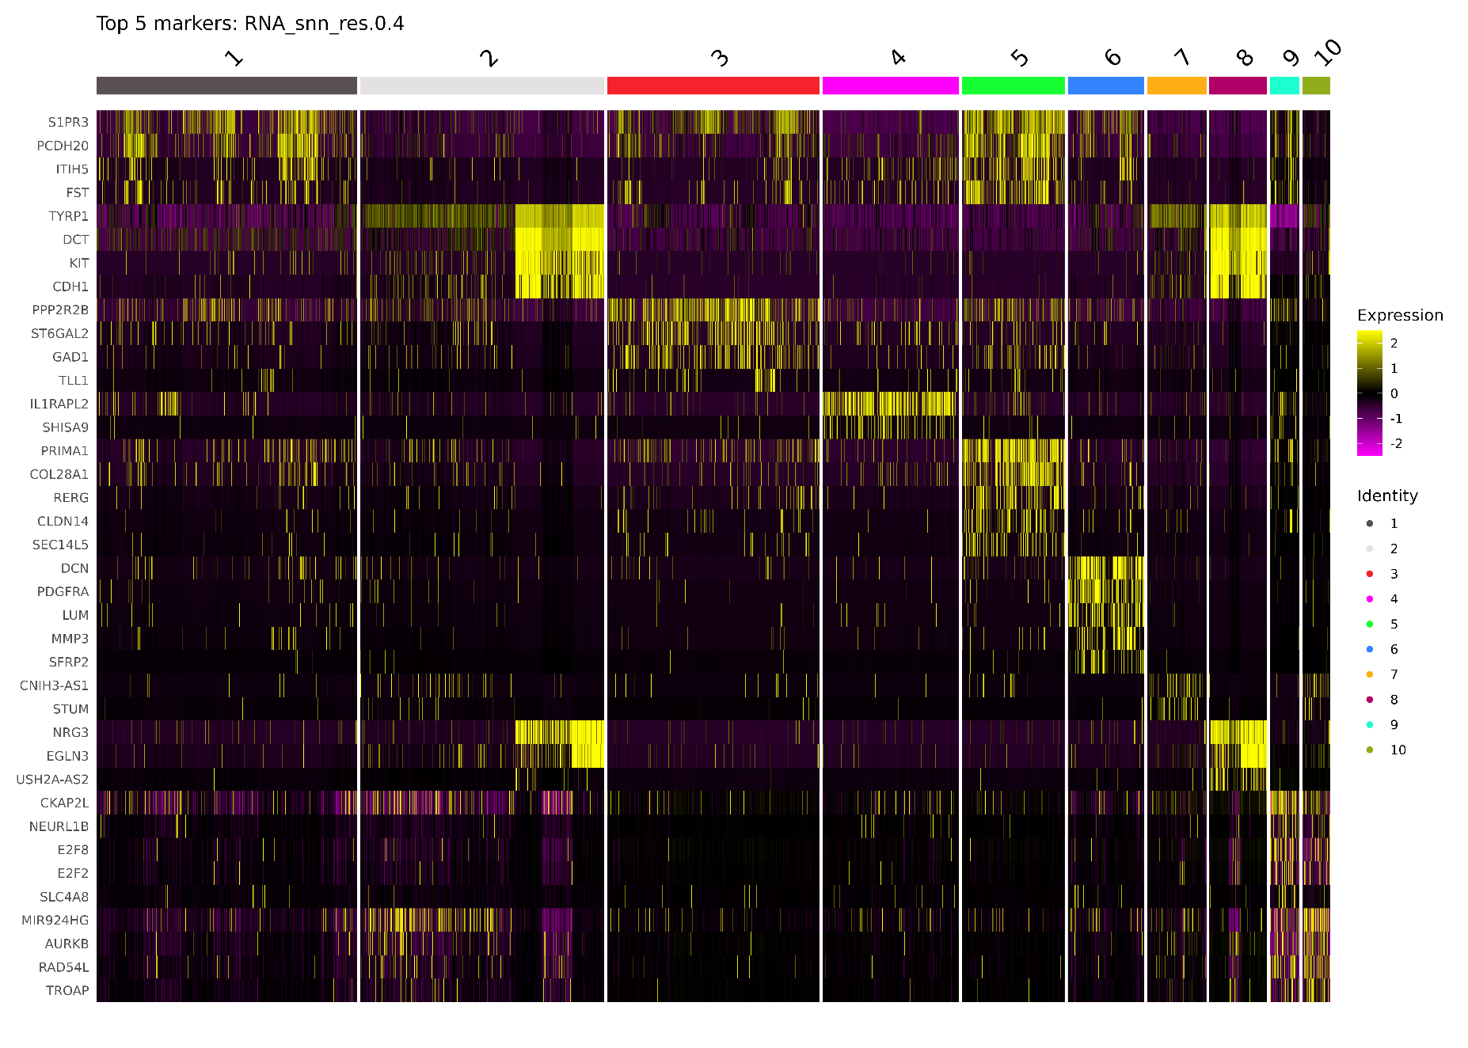
Marker expression

Slide 24
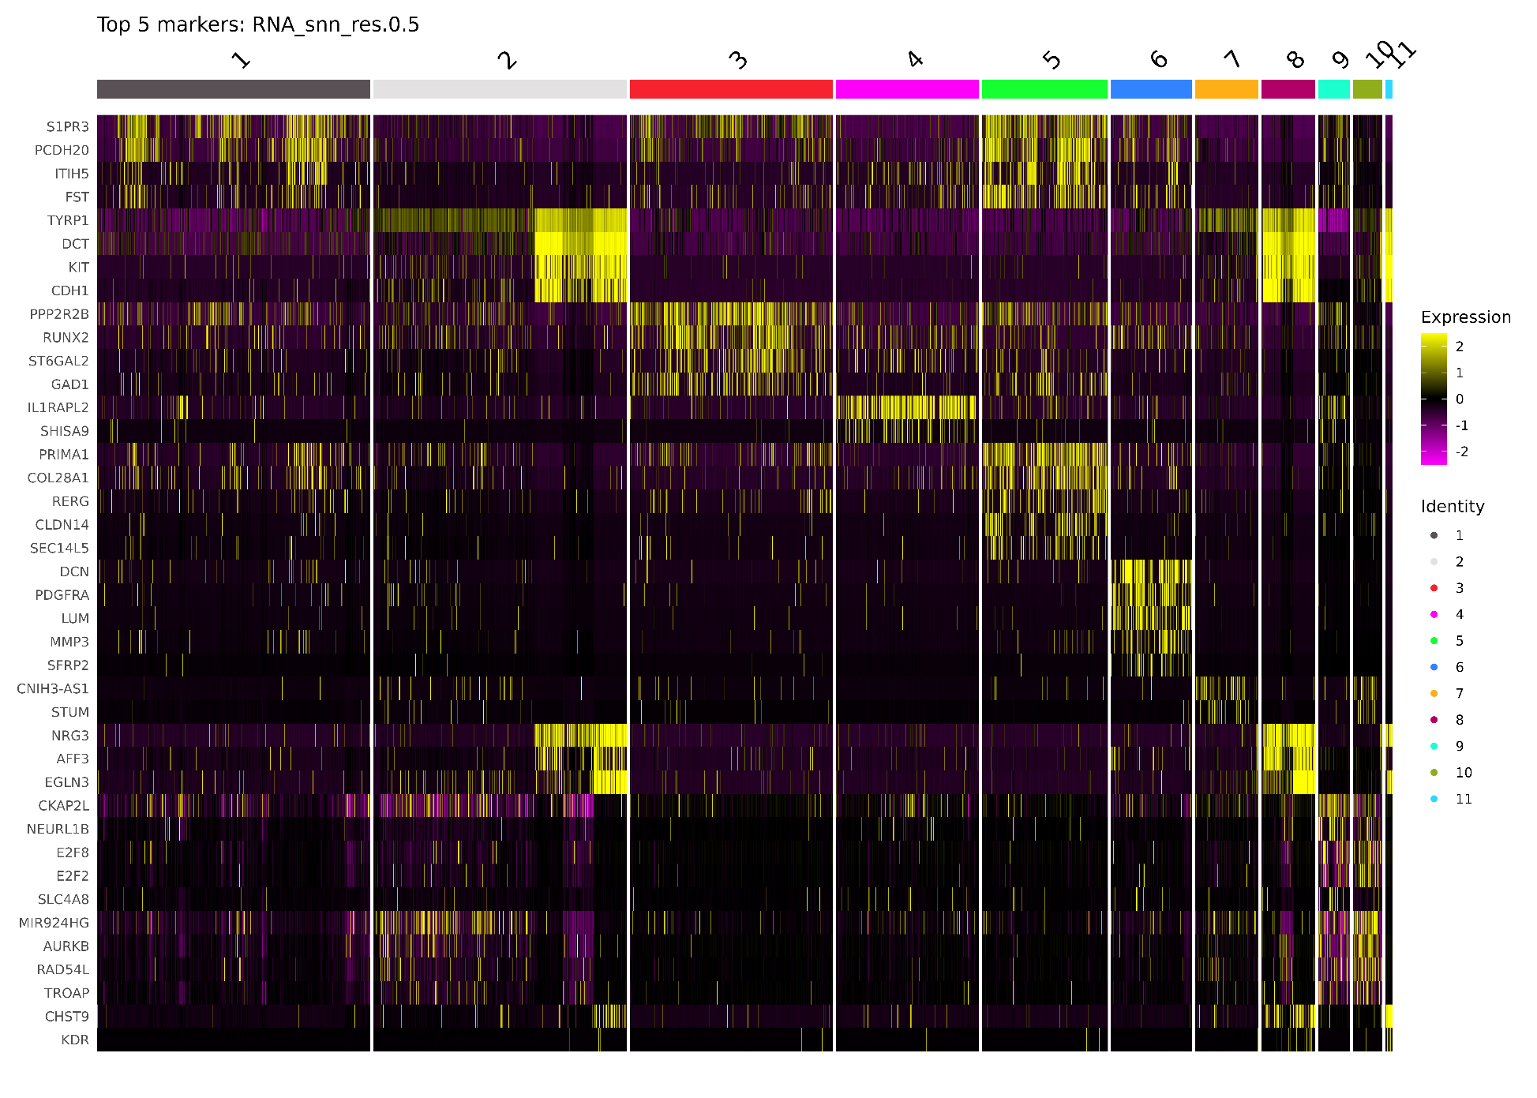
Marker expression

Slide 25
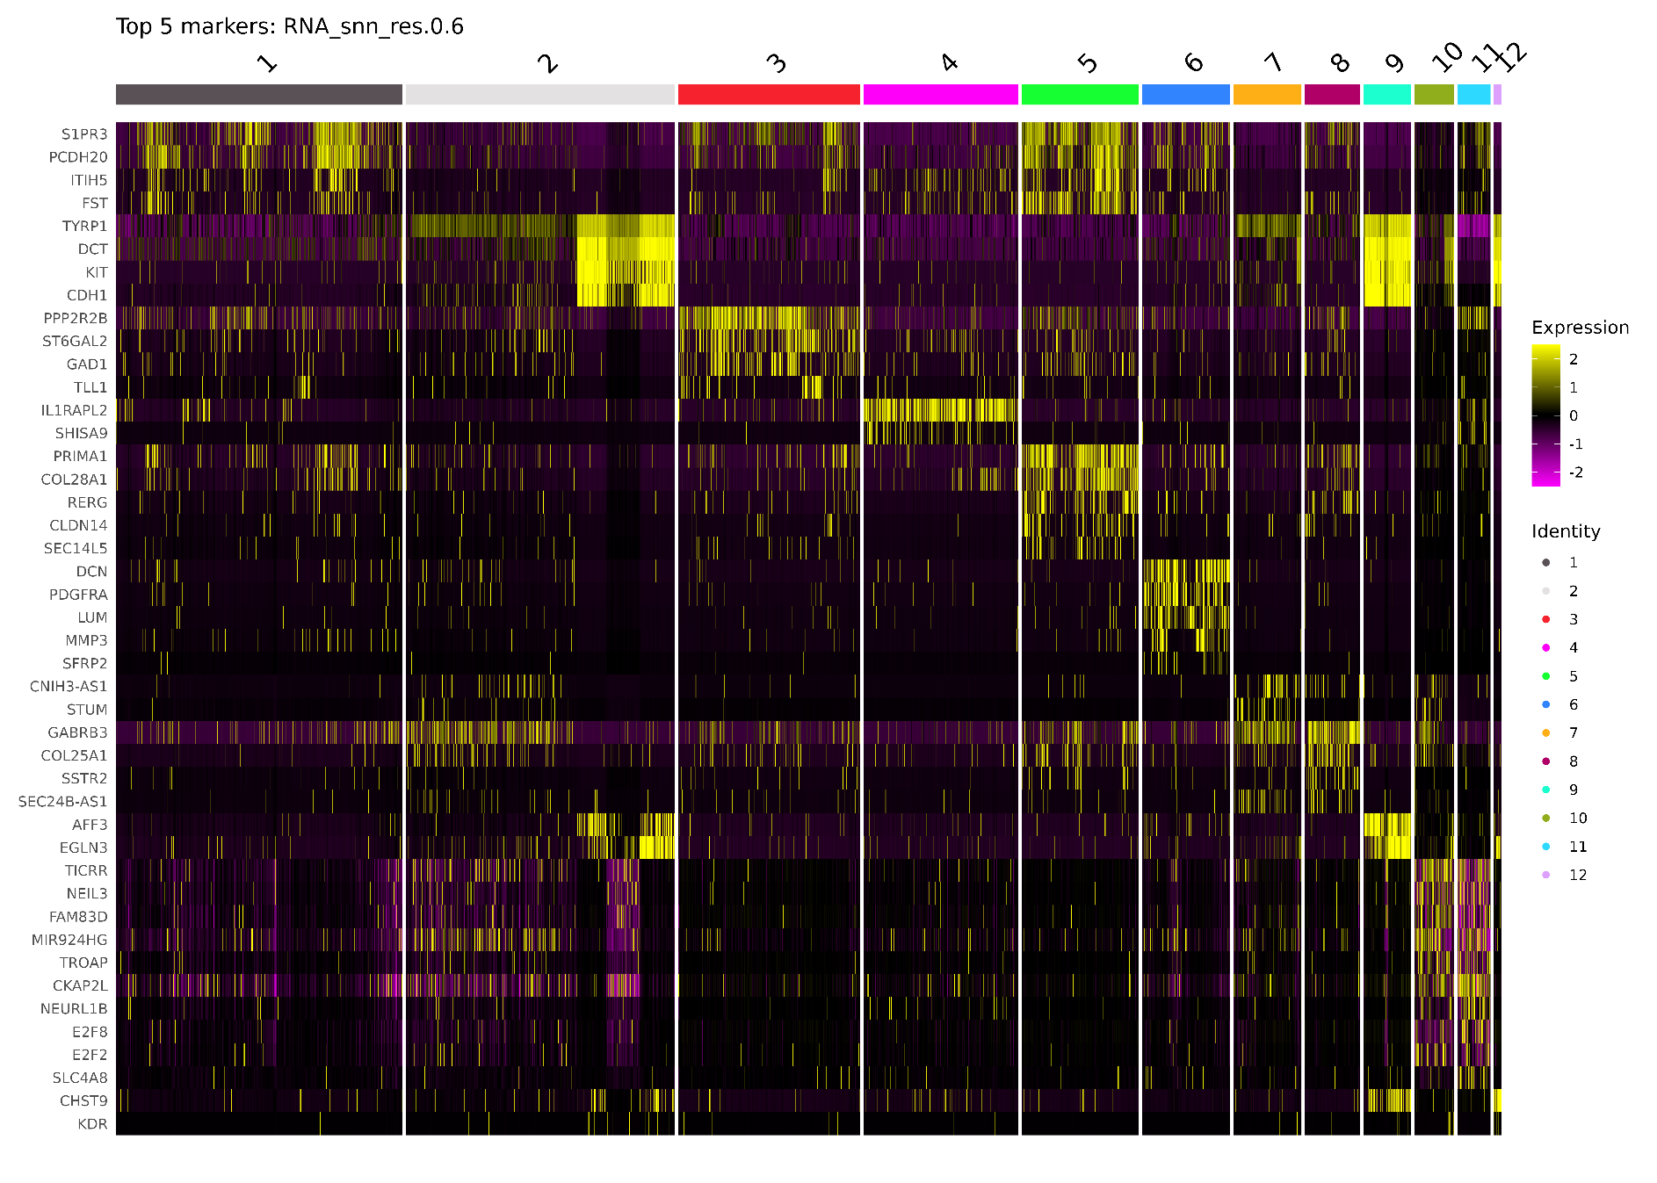
Marker expression

Slide 26
06-Data exploration

Slide 27
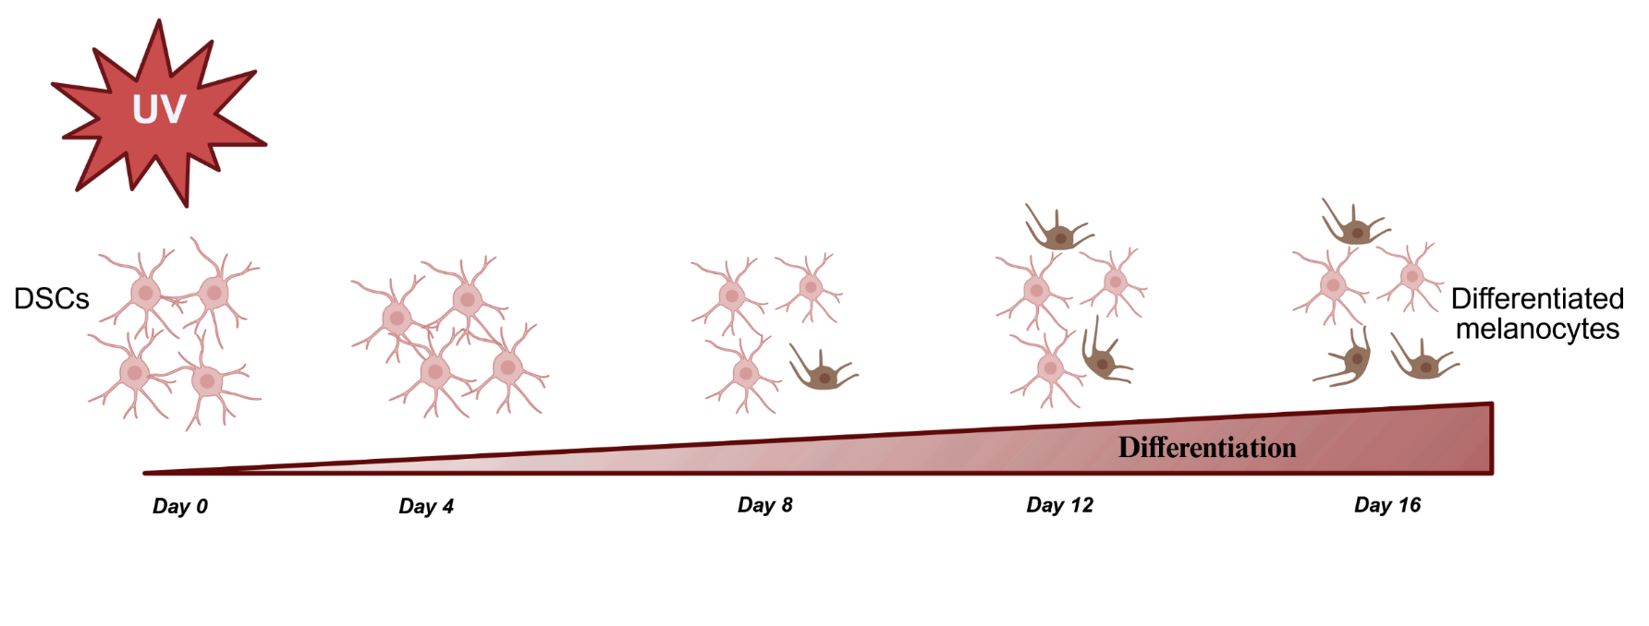
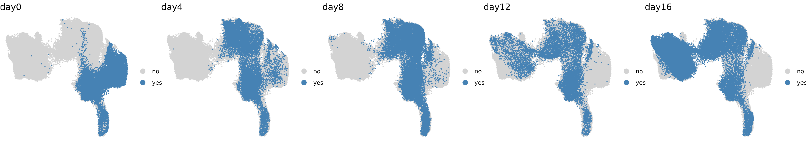
Dapi-MITF-HMB45

Slide 28
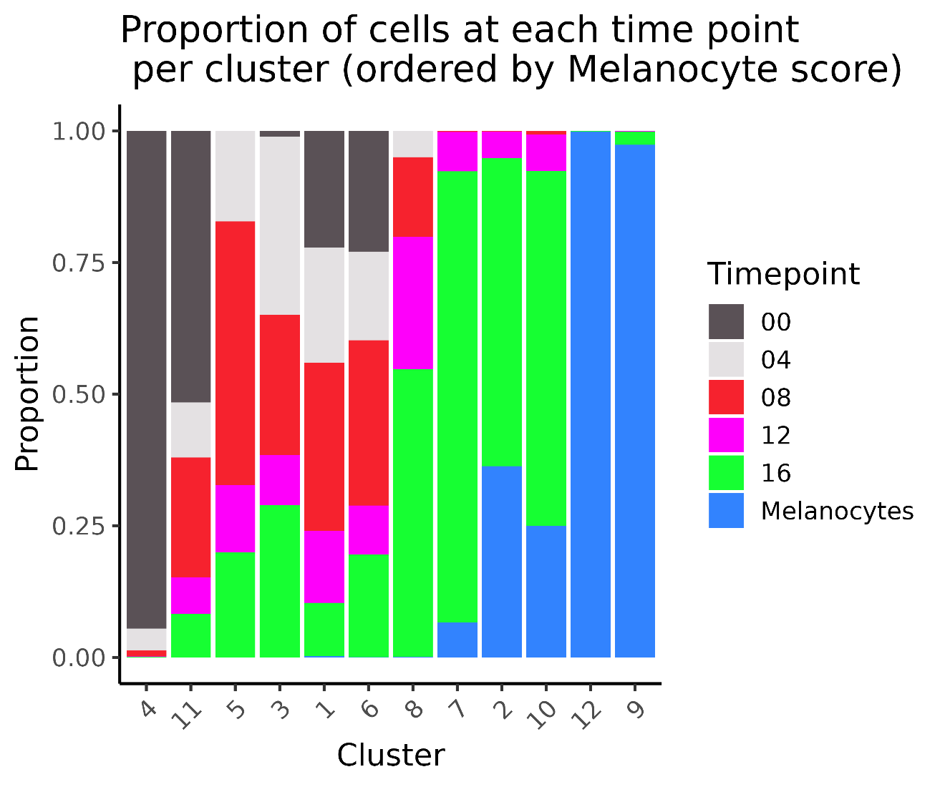
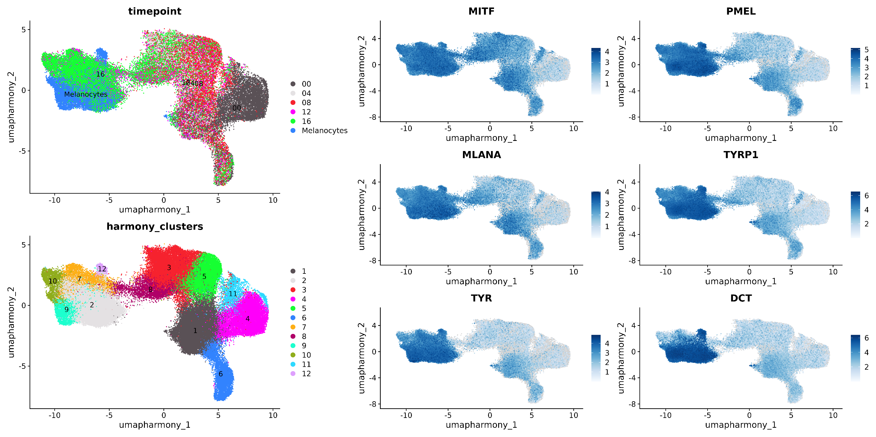
Timepoint distribution

Slide 29
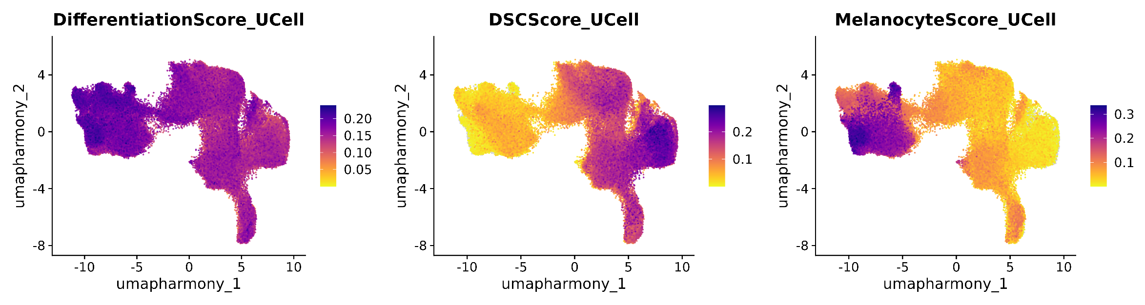
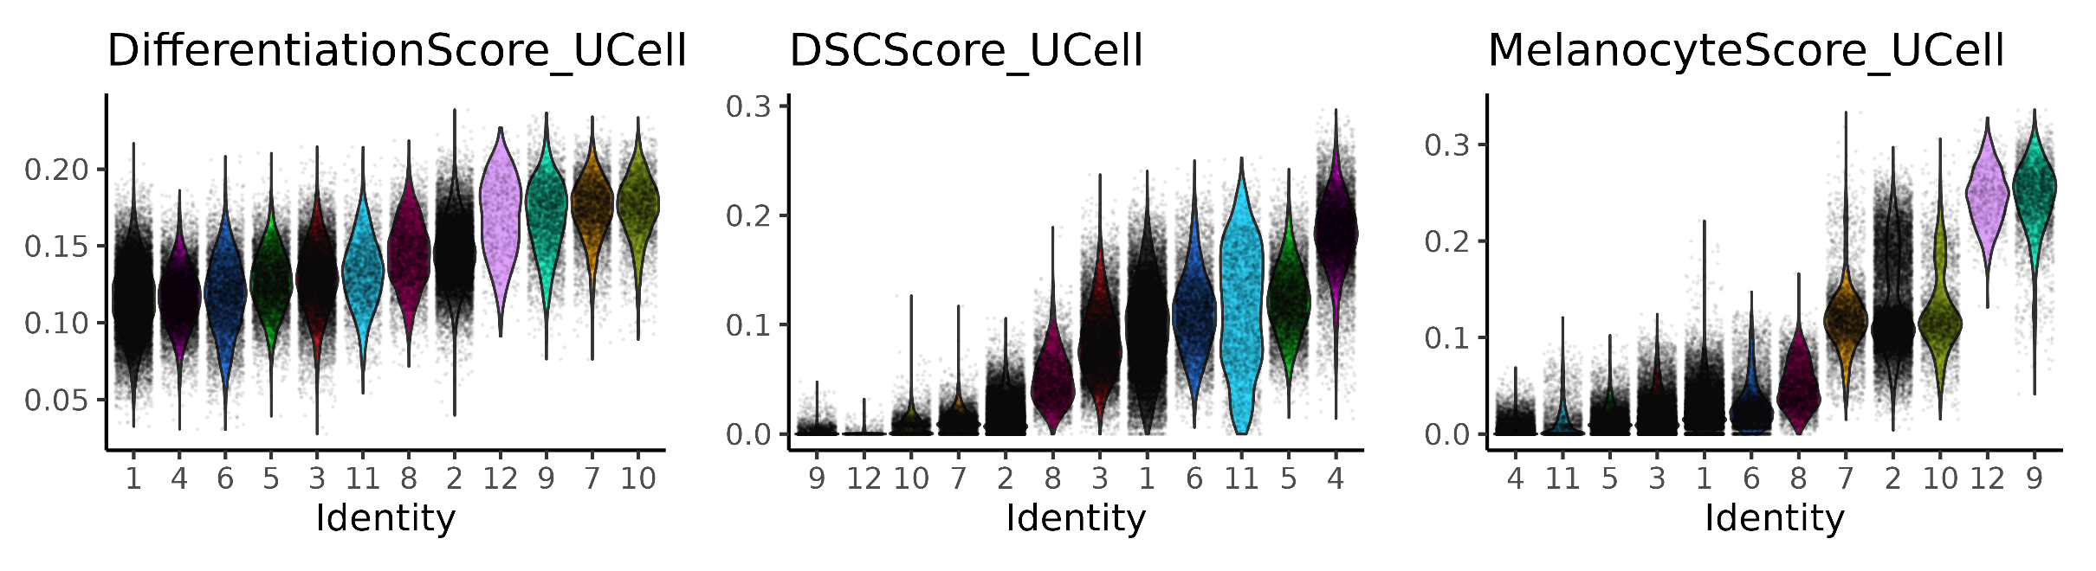
Differentiation scores

Slide 30
06a-DSC day 0 subpopulation

Slide 31
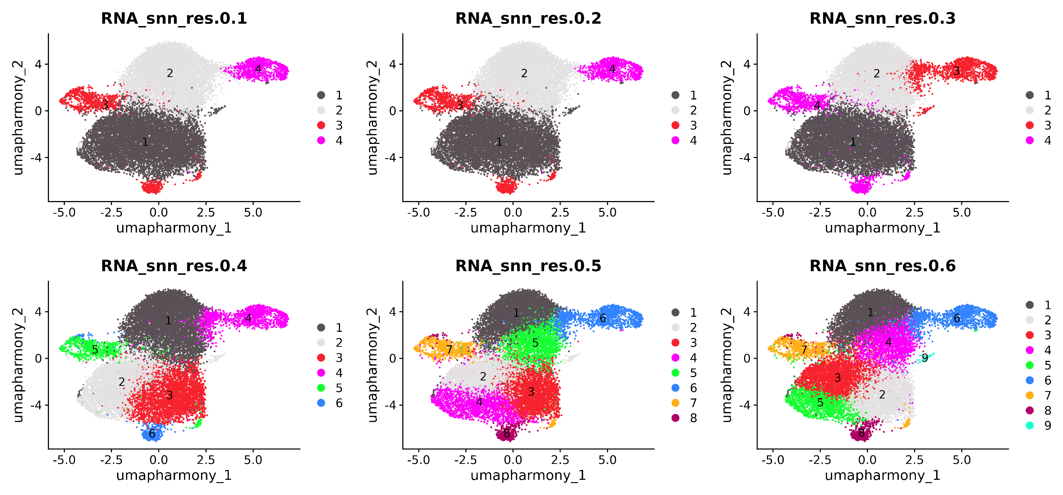

Slide 32
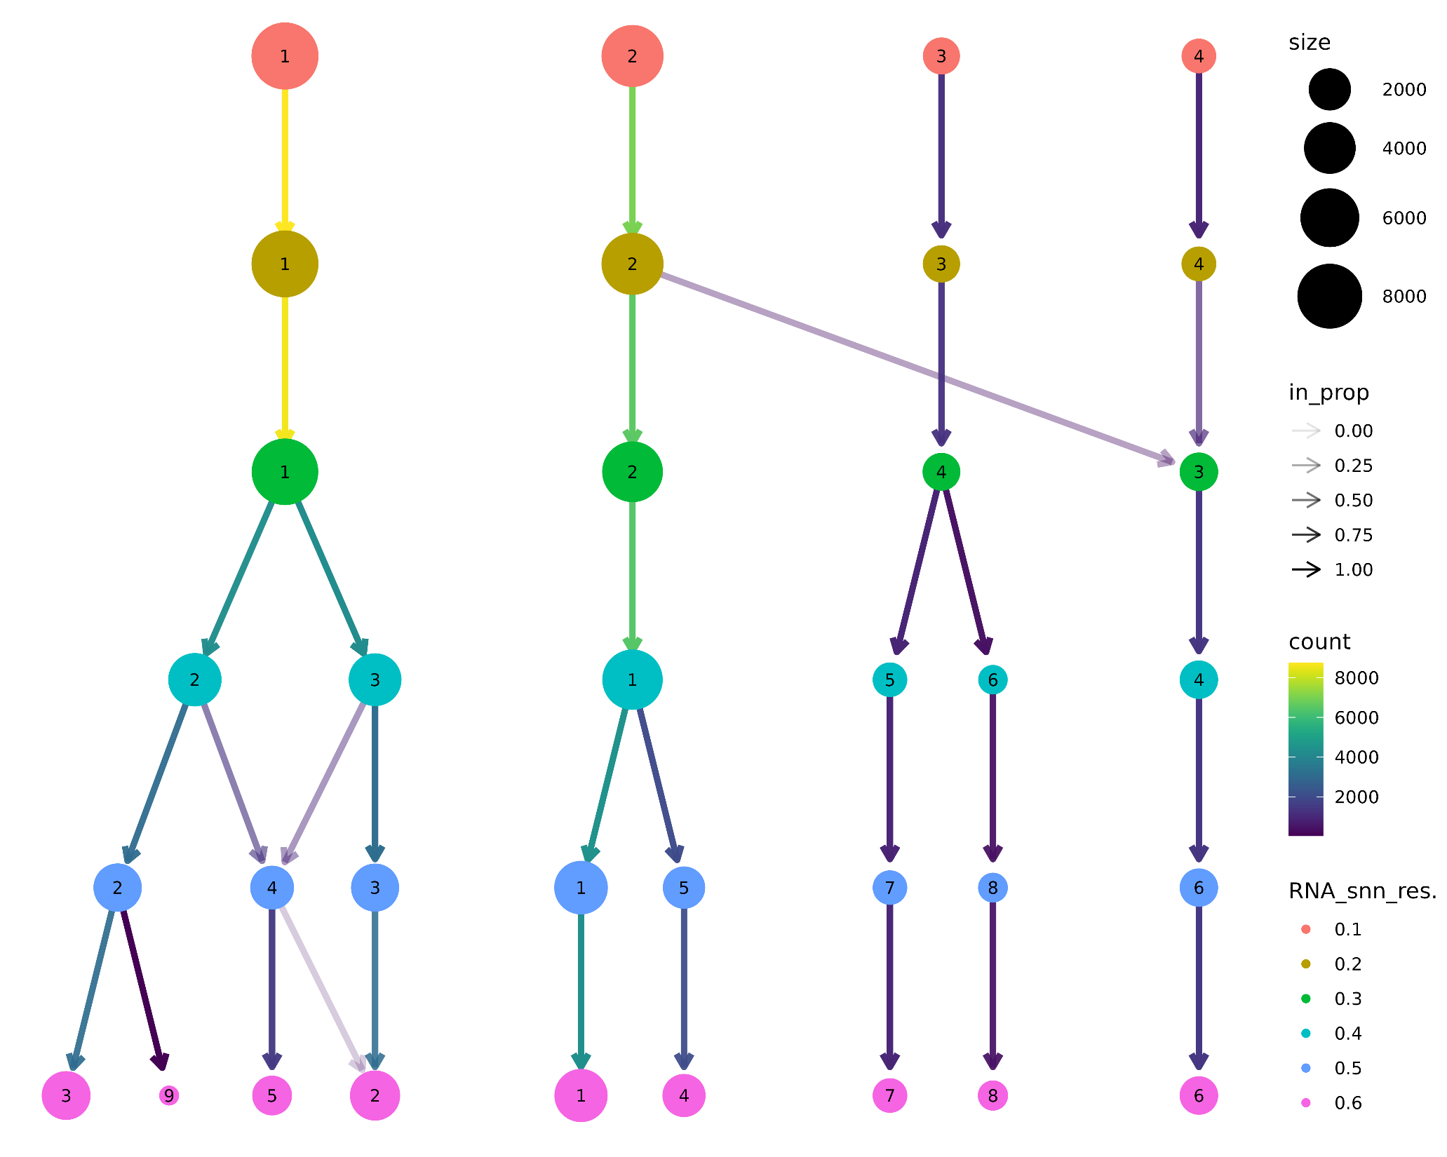

Slide 33
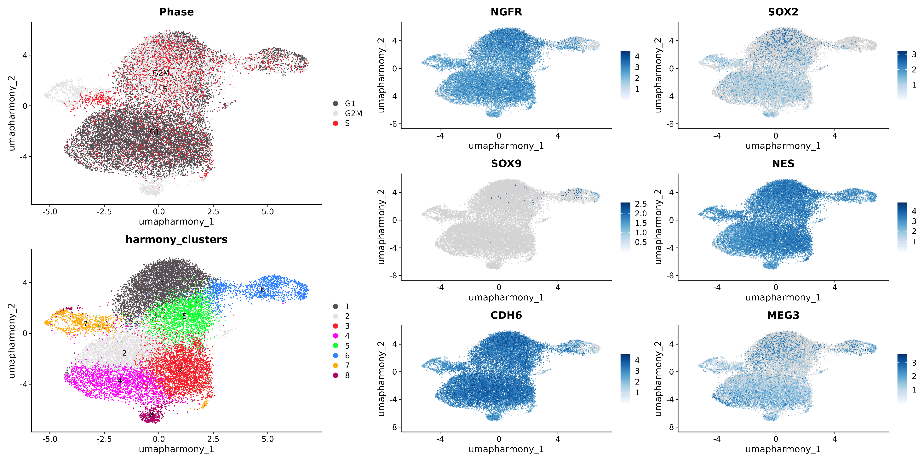
DSC markers

Slide 34
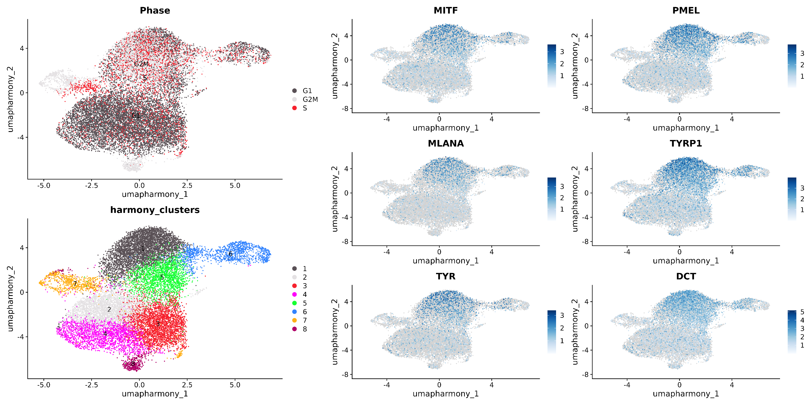
Melanocyte markers

Slide 35
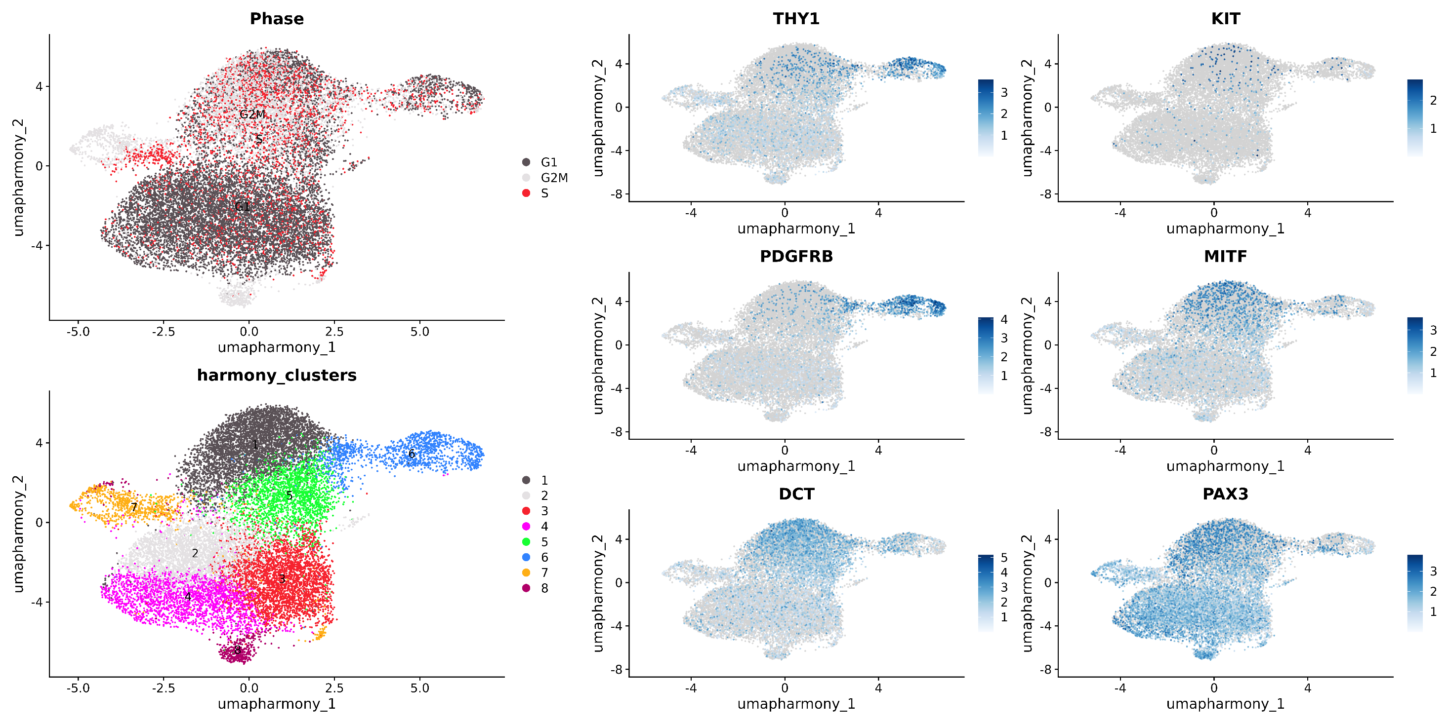
Melanocyte stem cell markers

Slide 36
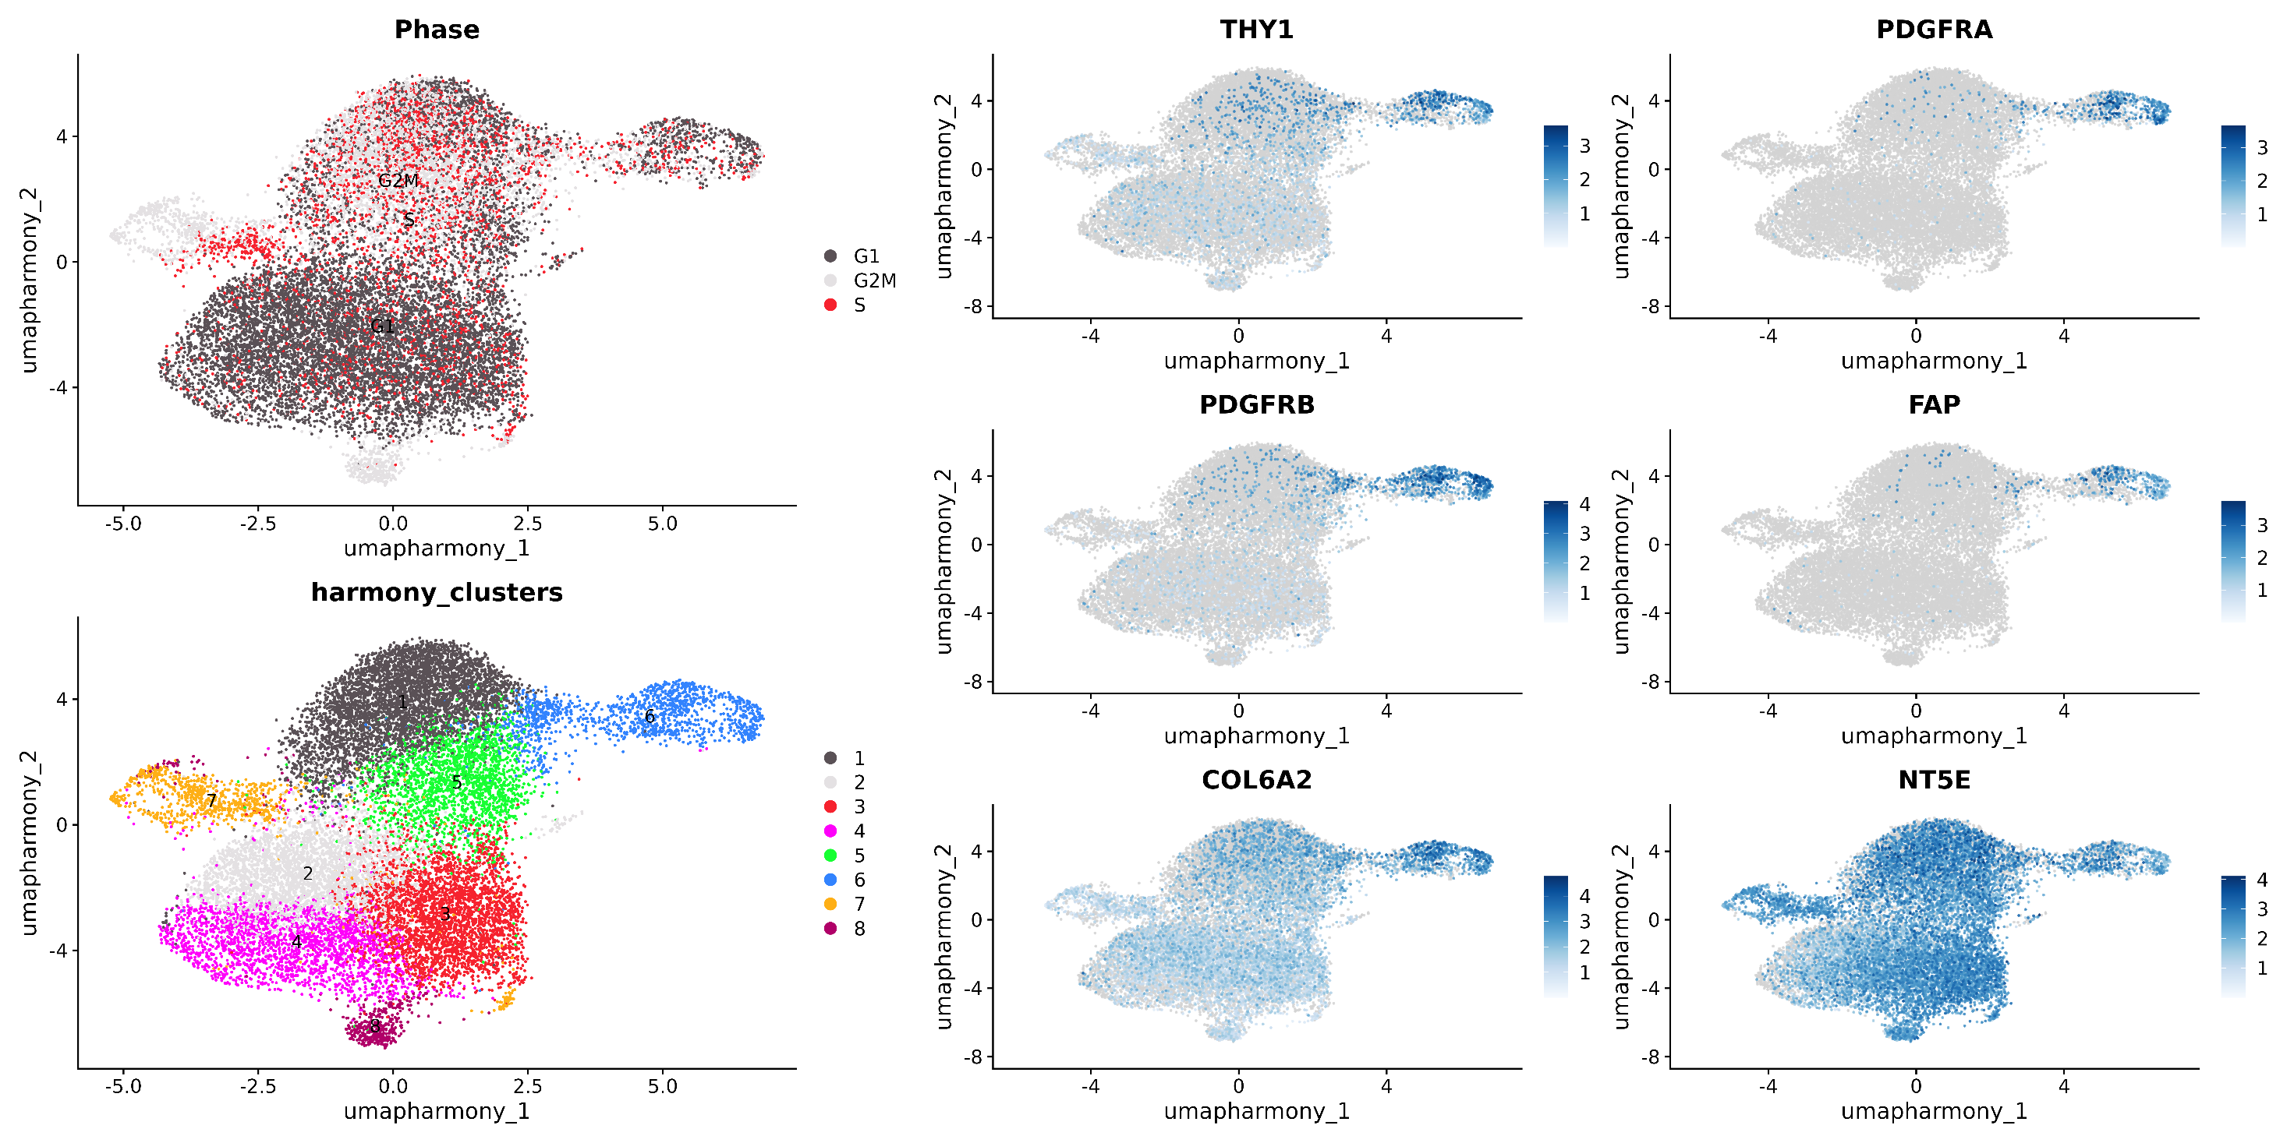
Fibroblast markers

Slide 37
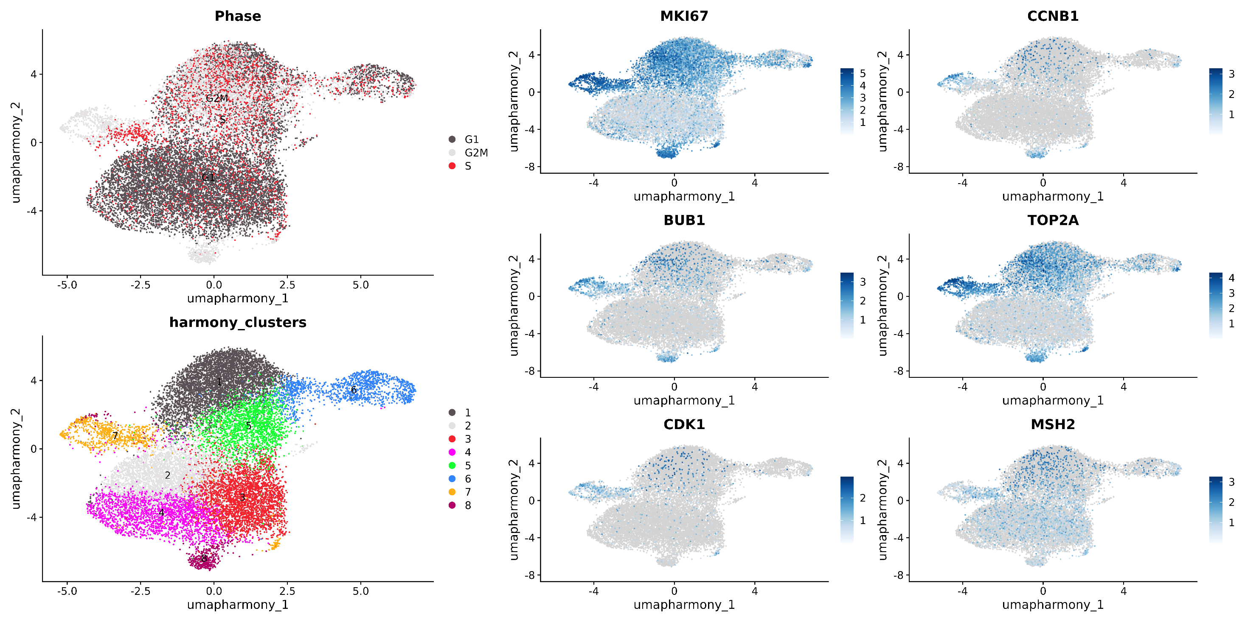
Cell cycle markers

Slide 38
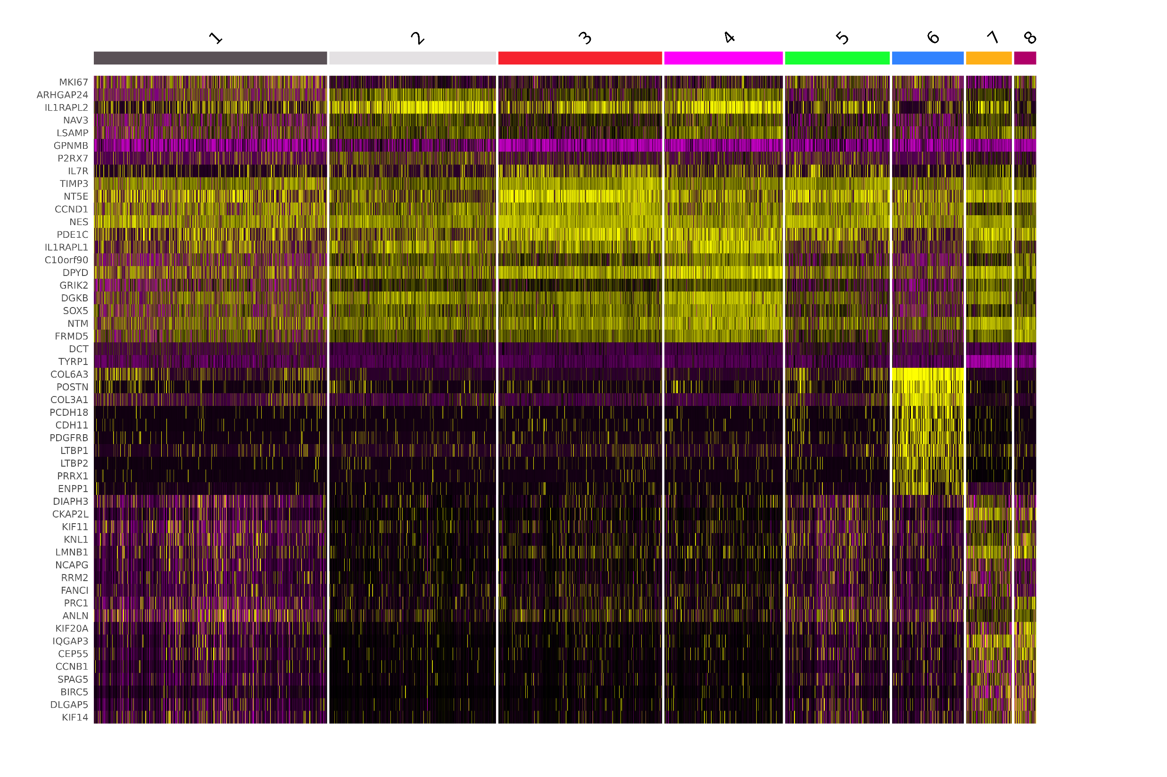
Cluster 6: Fibroblasts
Cluster 7&8: Cycling DSCs
Cluster 2,3 & 4: Stem cell reservoir?
Cluster 1 & 5: Melanocyte progenitors?
SOX5 is a marker of the neural-crest lineage
https://pubmed.ncbi.nlm.nih.gov/18703590/

Slide 39
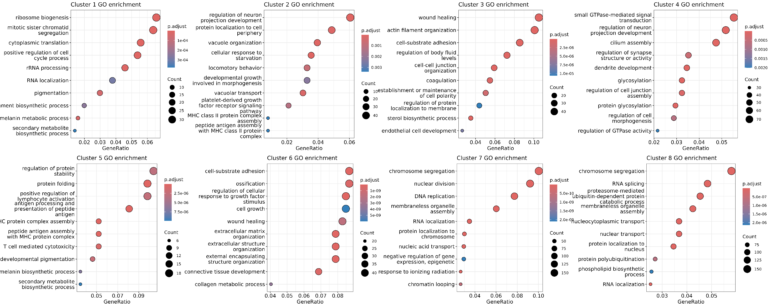
GOBP terms per cluster

Slide 40
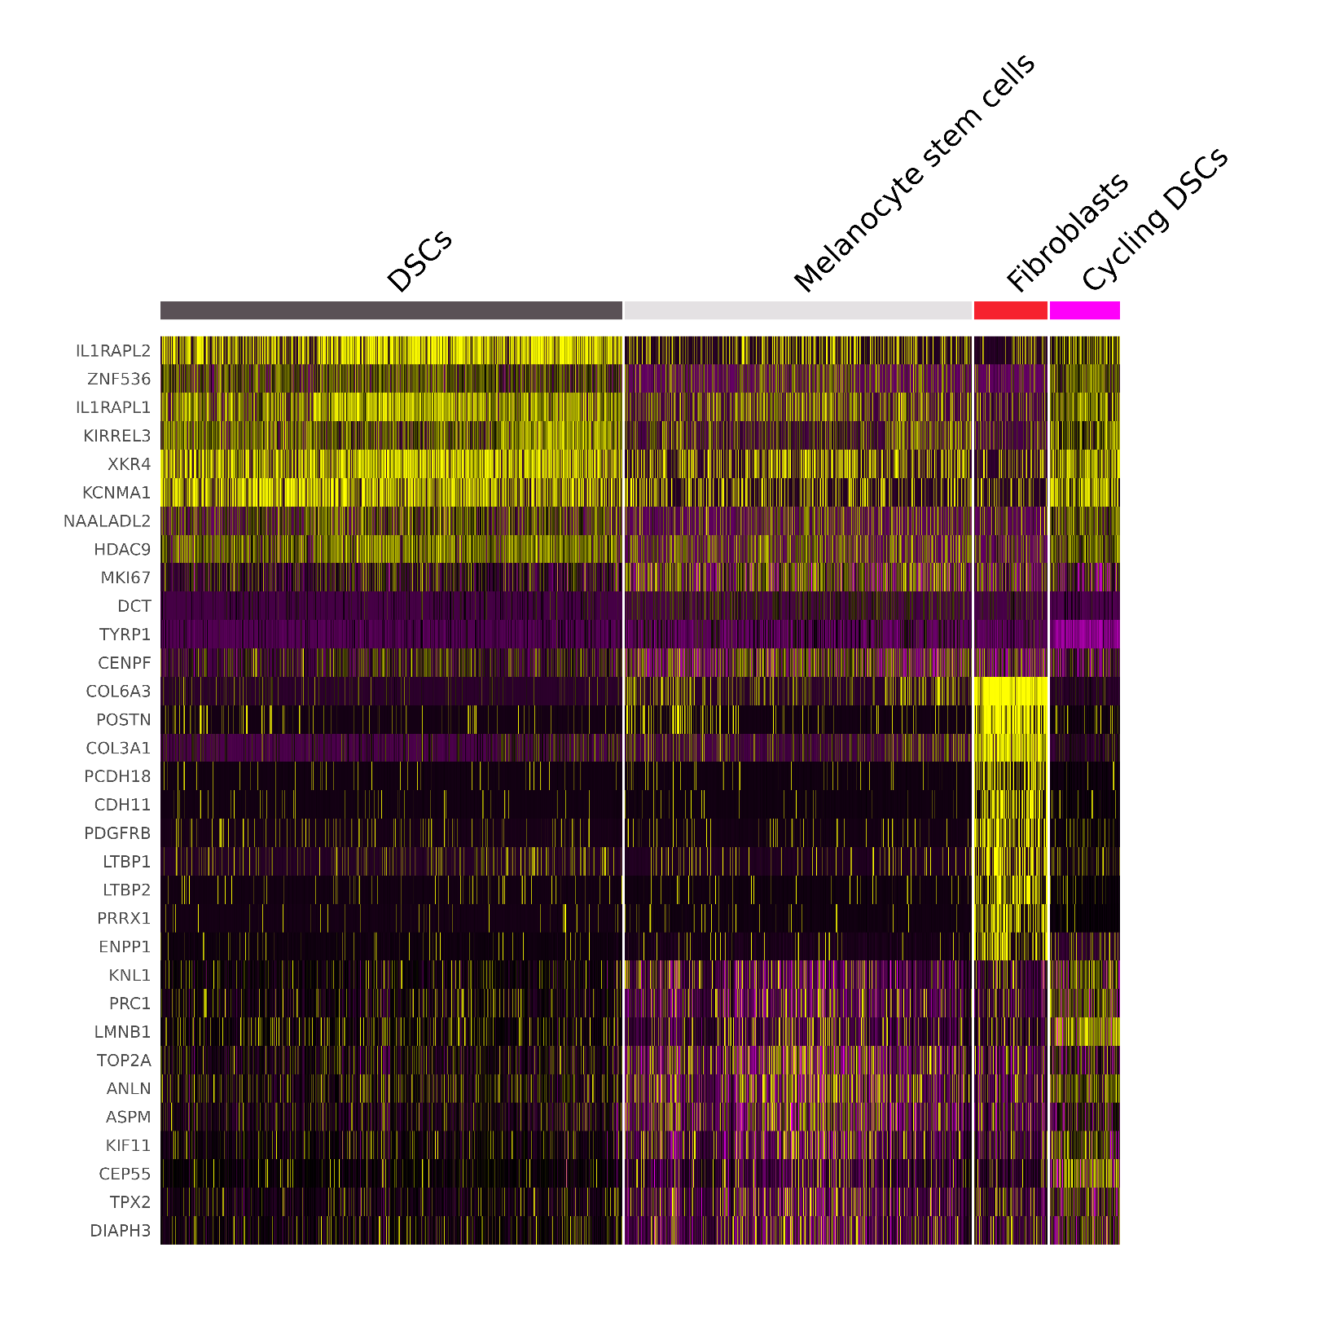
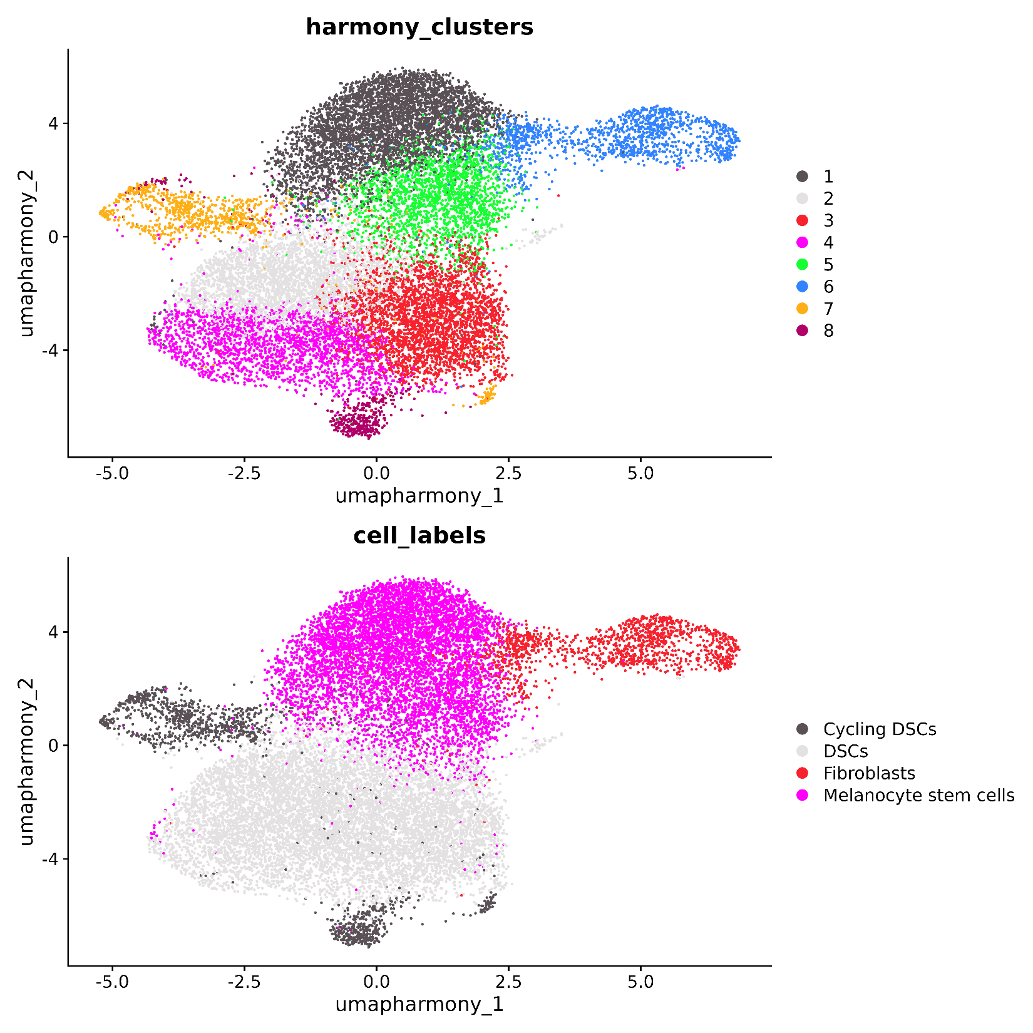
Initial cluster assignment

Slide 41
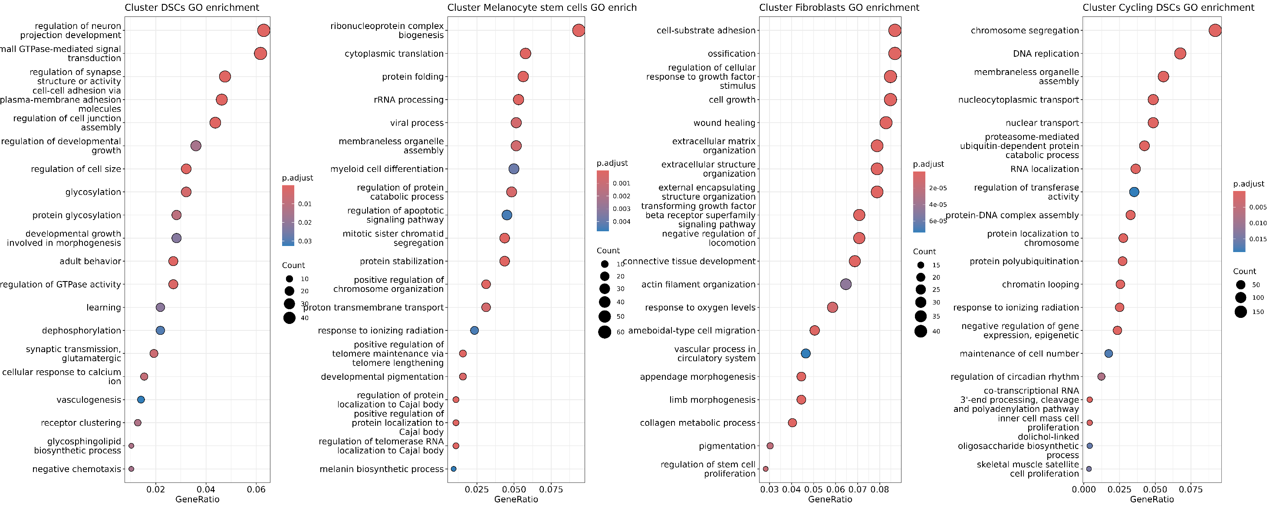
GOBP terms per cell cluster
GO Terms confirm cluster identity!

Slide 42
06b-Epidermal melanocyte subpopulation

Slide 43
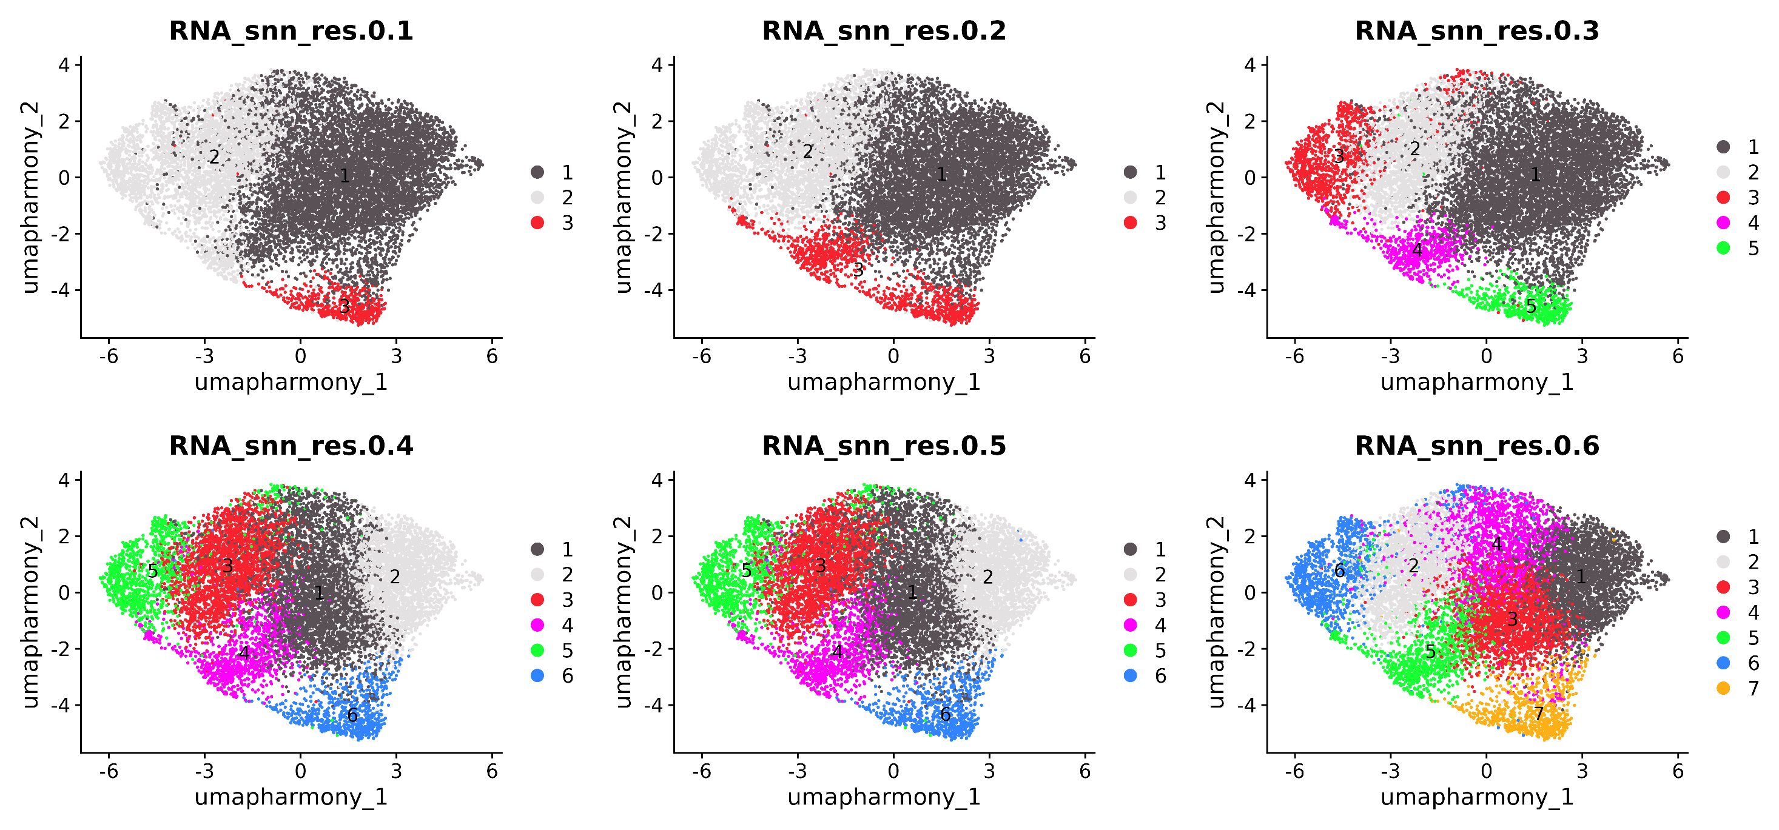

Slide 44
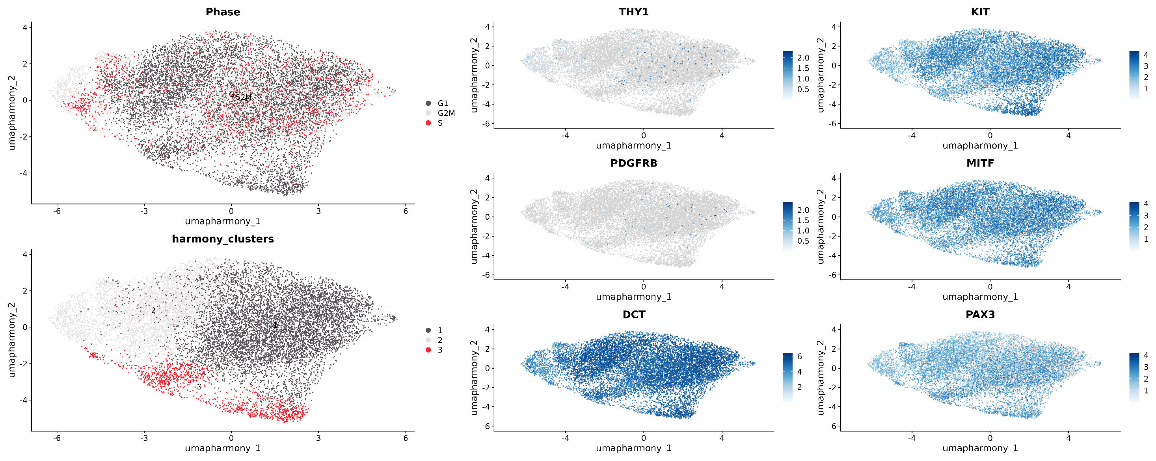

Slide 45
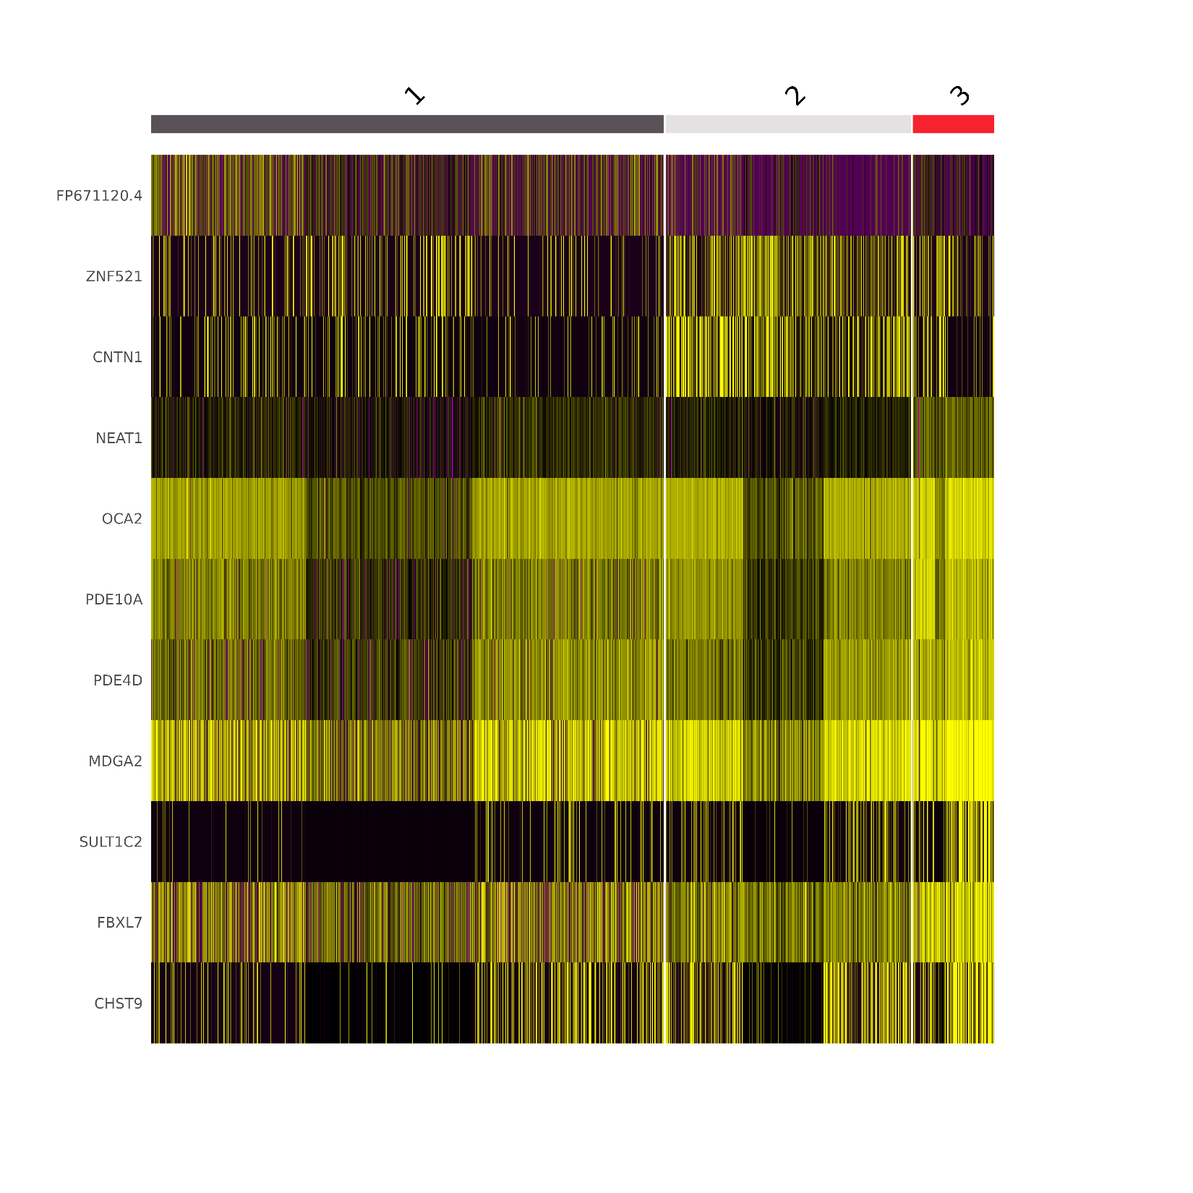
No real marker differences and high homogeneity. Just one melanocyte population (in the mature melanocytes)

Slide 46
06c-Melanocyte markers

Slide 47
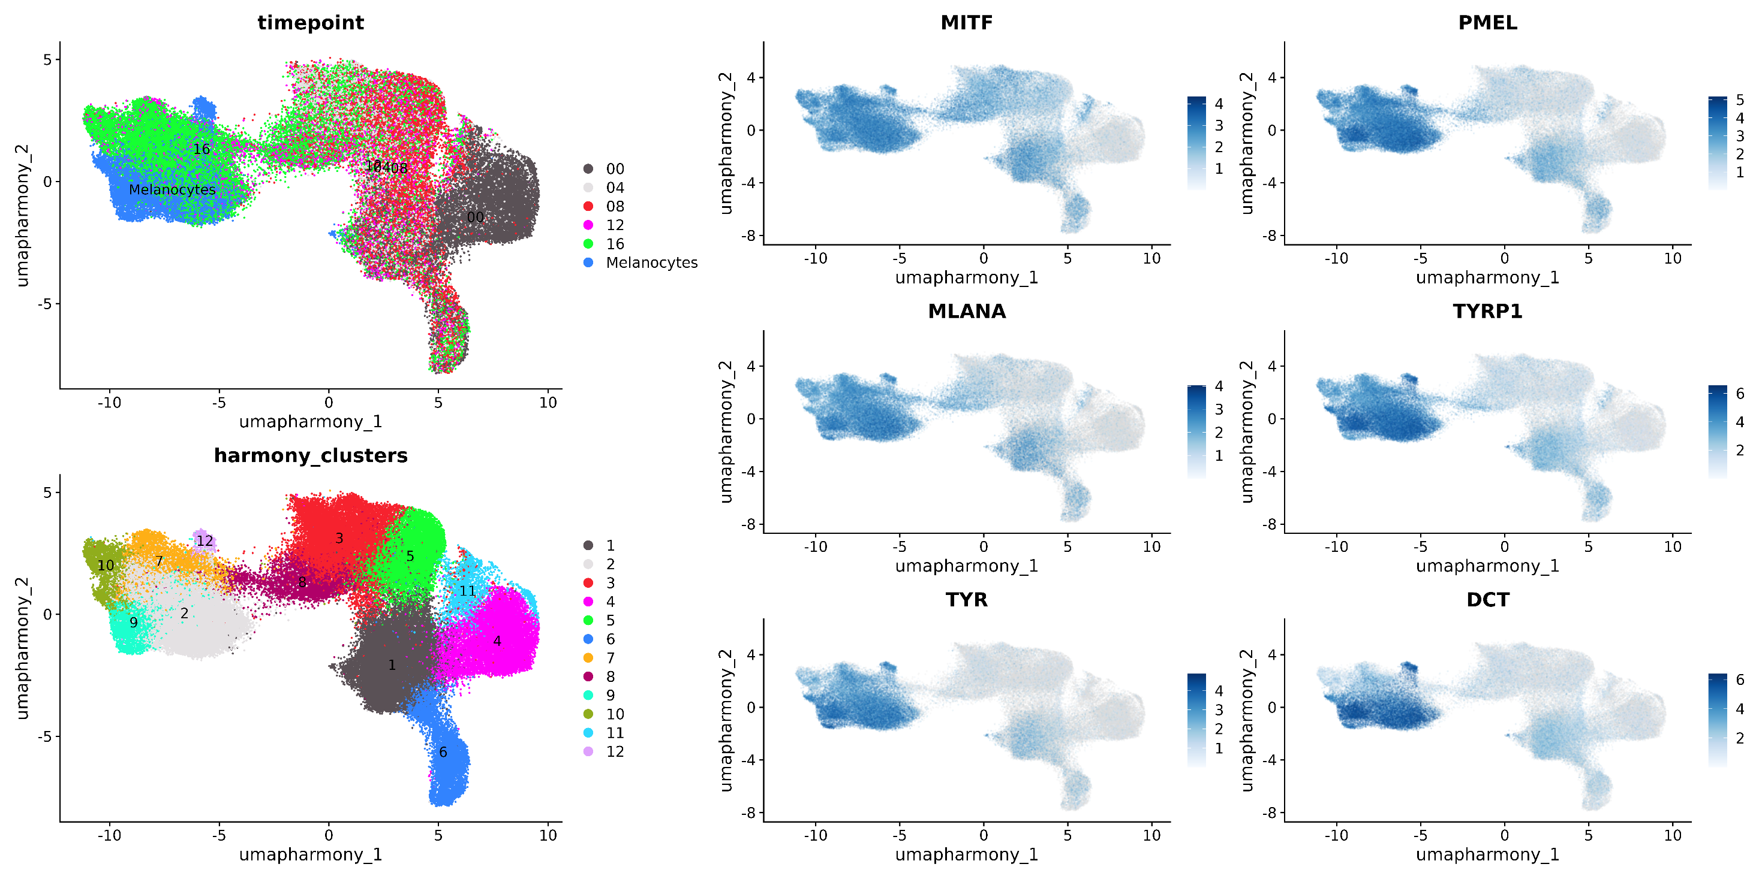

Slide 48
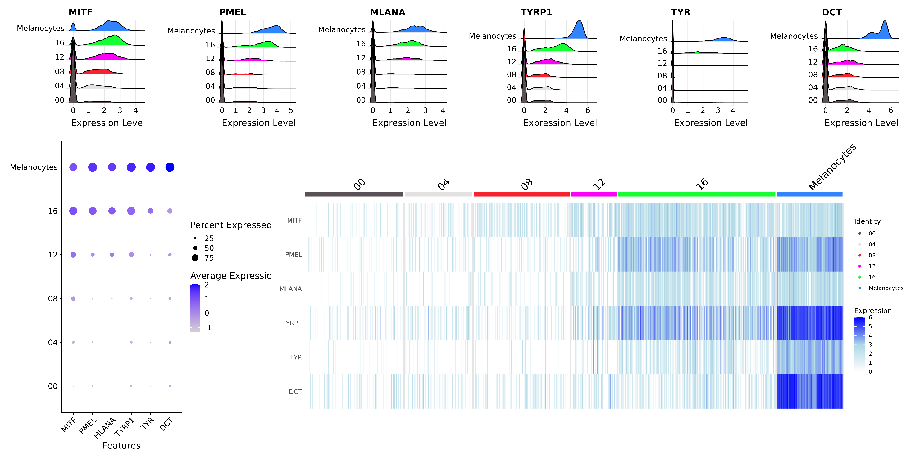

Slide 49
06d-Melanocyte stem cell markers

Slide 50
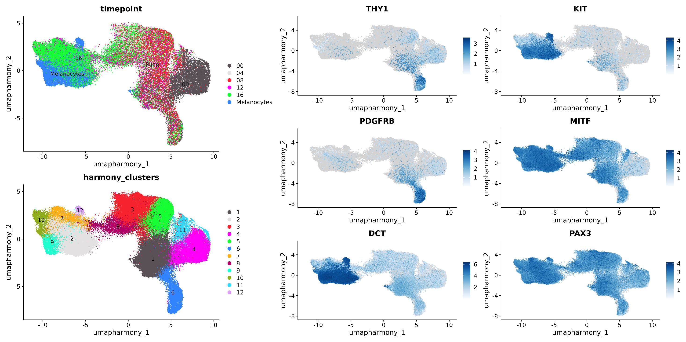
MSCs are described differentially in the literature: PDGFRB (fibroblast marker) is also associated with MSCs. CD90+/KIT- progenitors have been described as a MSC subpopulation. Also DCT+/MITF- cells were proposed as MSCs.

Slide 51
06e-DSC markers

Slide 52
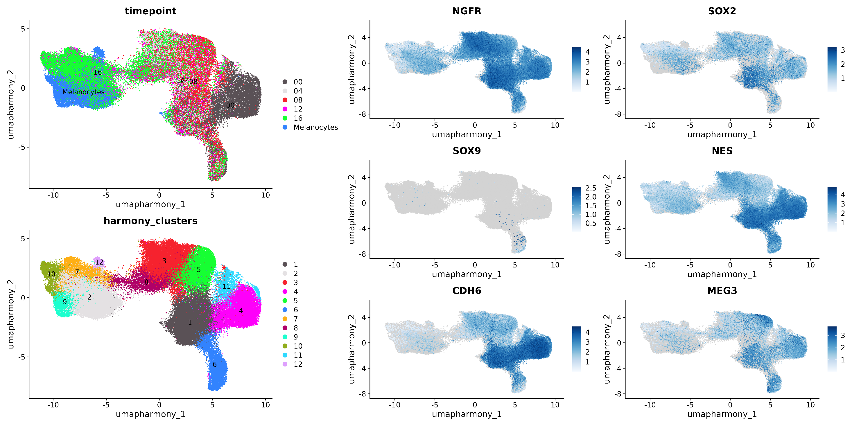

Slide 53
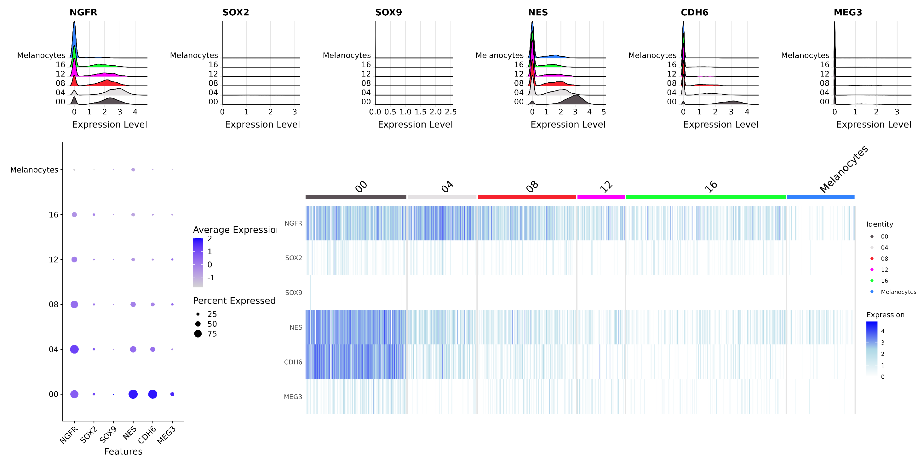

Slide 54
06f-Fibroblast markers

Slide 55
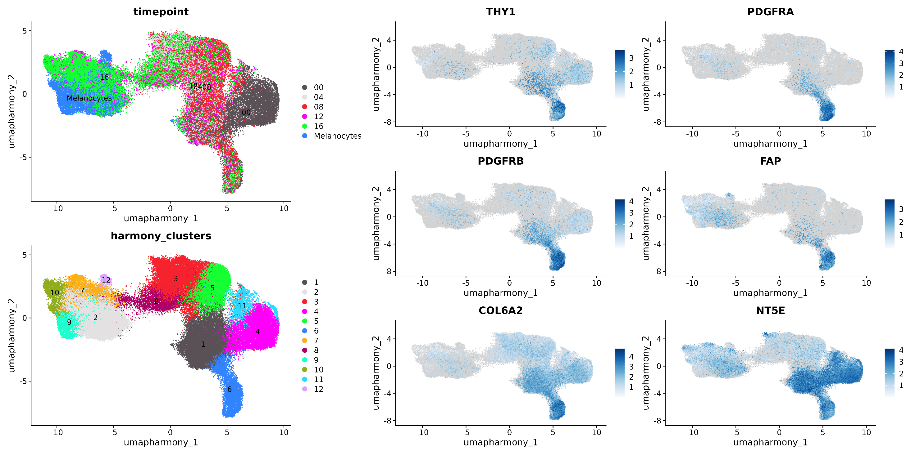

Slide 56
07-Trajectory inference

Slide 57
TI workflow
To reconstruct the differentiation trajectory from dermal stem cells to melanocytes, we performed comprehensive trajectory inference using both diffusion pseudotime (DPT) and principal curve fitting methods. Initial preprocessing was conducted in Seurat (vX.X.X): after standard quality control, we excluded fibroblast and epidermal melanocyte populations by subsetting the Seurat object to retain only dermal stem cells and their direct derivatives. Following subsetting, we re-calculated the cellular neighborhood graph using the first 30 principal components (FindNeighbors, dims = 1:30), and performed clustering with the Leiden algorithm (FindClusters, resolution = 0.5). For visualization purposes, UMAP embeddings were computed using the same 30 principal components. However, for lineage inference, we leveraged diffusion maps, which have been shown to better preserve continuous differentiation trajectories and underlying manifold structures compared to UMAP, especially in studies of developmental biology and cellular differentiation (Haghverdi et al., 2016; Coifman et al., 2005). Diffusion maps were generated using the first 20 principal components to optimize computational efficiency and reduce noise from higher components. Pseudotime ordering was performed with destiny's DPT algorithm (destiny vX.X.X), using the diffusion map embedding as input. For downstream gene expression modeling along pseudotime, we fitted principal curves with Slingshot (vX.X.X), again using the diffusion map coordinates as input (approx_points = 100, stretch = 0). This enabled robust lineage assignment and provided a smooth trajectory for differential expression analysis with tradeSeq. All analyses were performed in R (vX.X.X) with default parameters unless otherwise specified.
References:
Haghverdi, L., Büttner, M., Wolf, F. A., Buettner, F., & Theis, F. J. (2016). Diffusion pseudotime robustly reconstructs lineage branching. Nature Methods, 13(10), 845–848.
Coifman, R. R., Lafon, S., Lee, A. B., Maggioni, M., Nadler, B., Warner, F., & Zucker, S. W. (2005). Geometric diffusions as a tool for harmonic analysis and structure definition of data: Diffusion maps. Proceedings of the National Academy of Sciences, 102(21), 7426–7431.

Slide 58
07-Trajectory inference
Cluster exploration

Slide 59
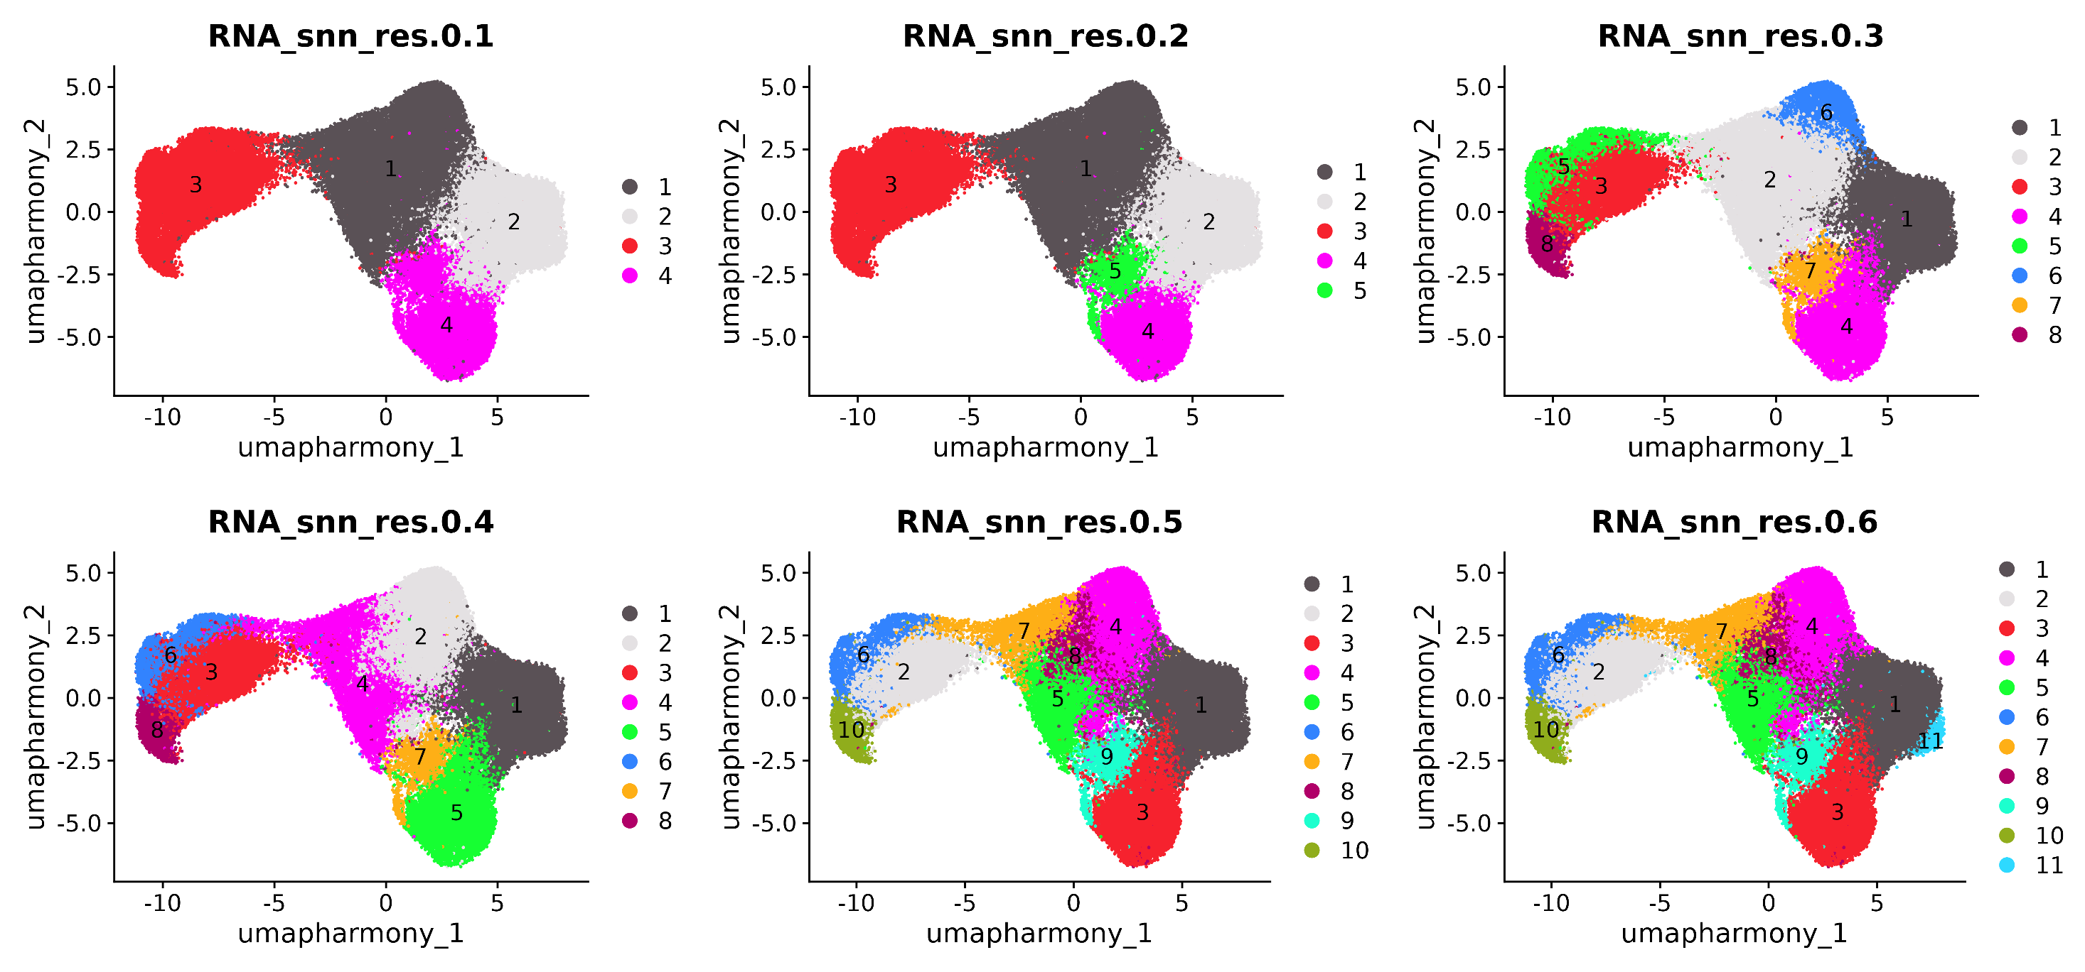

Slide 60
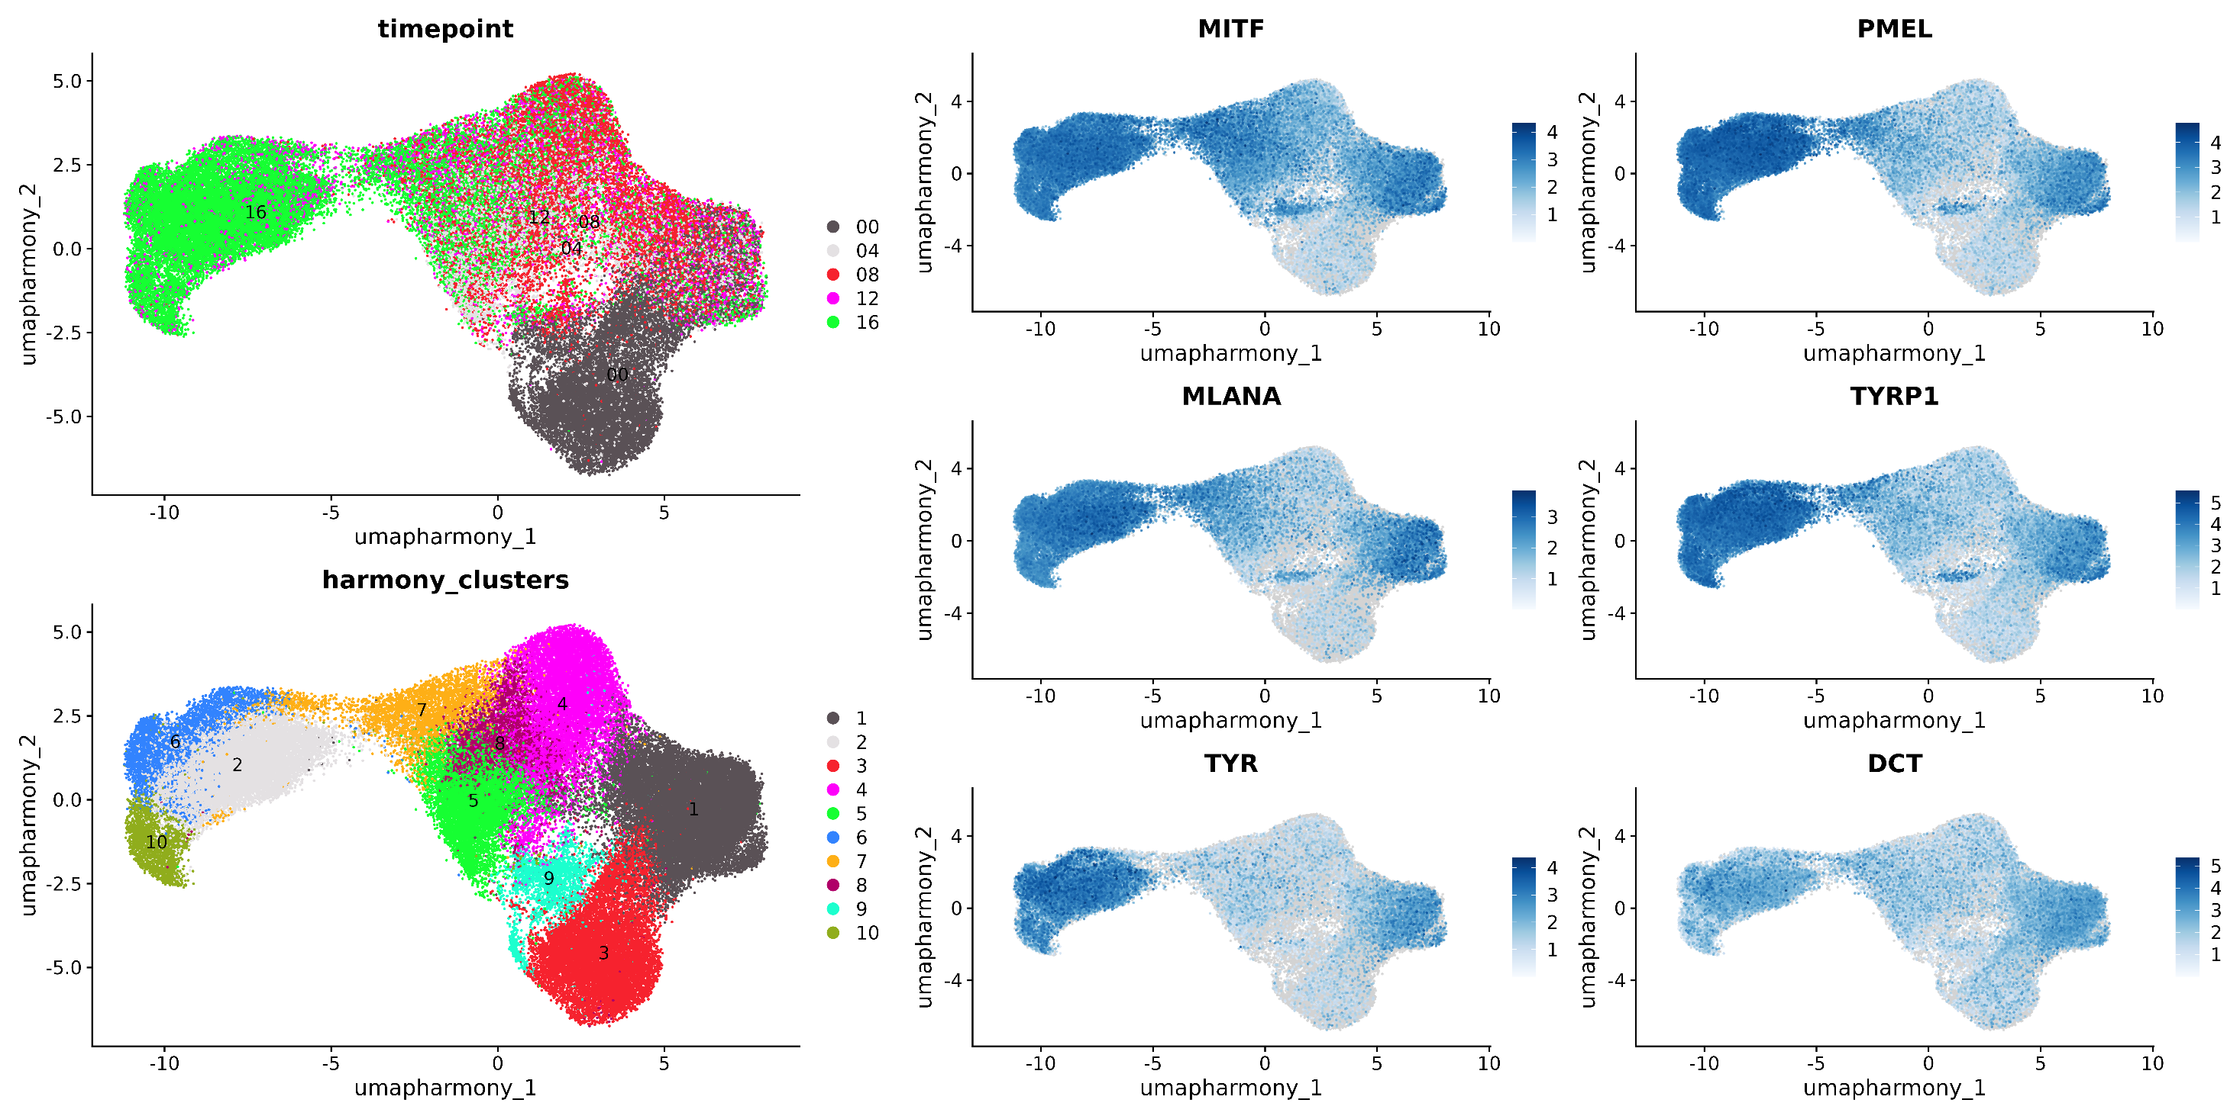

Slide 61
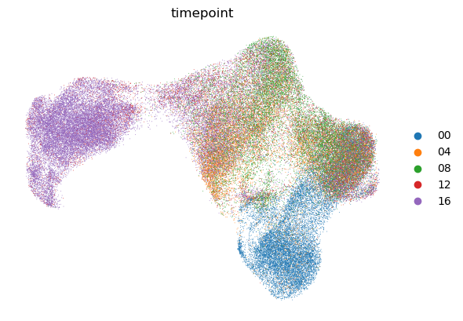
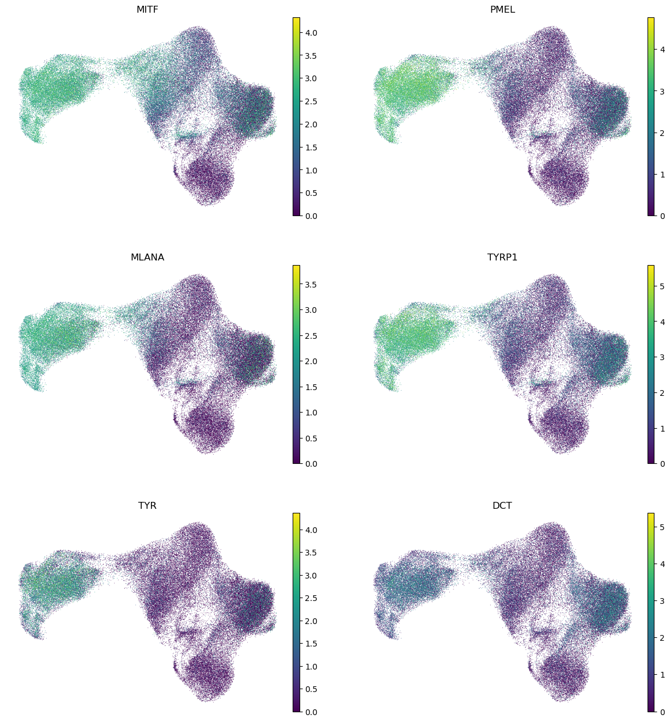
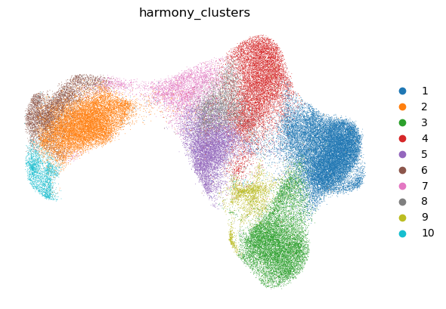

Slide 62
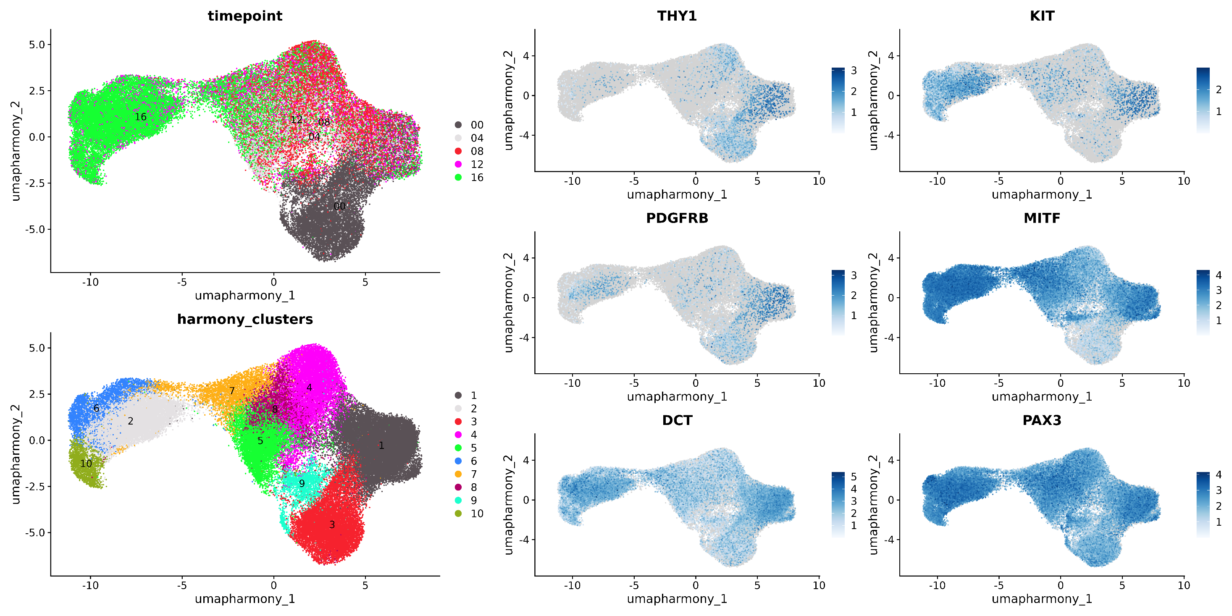

Slide 63
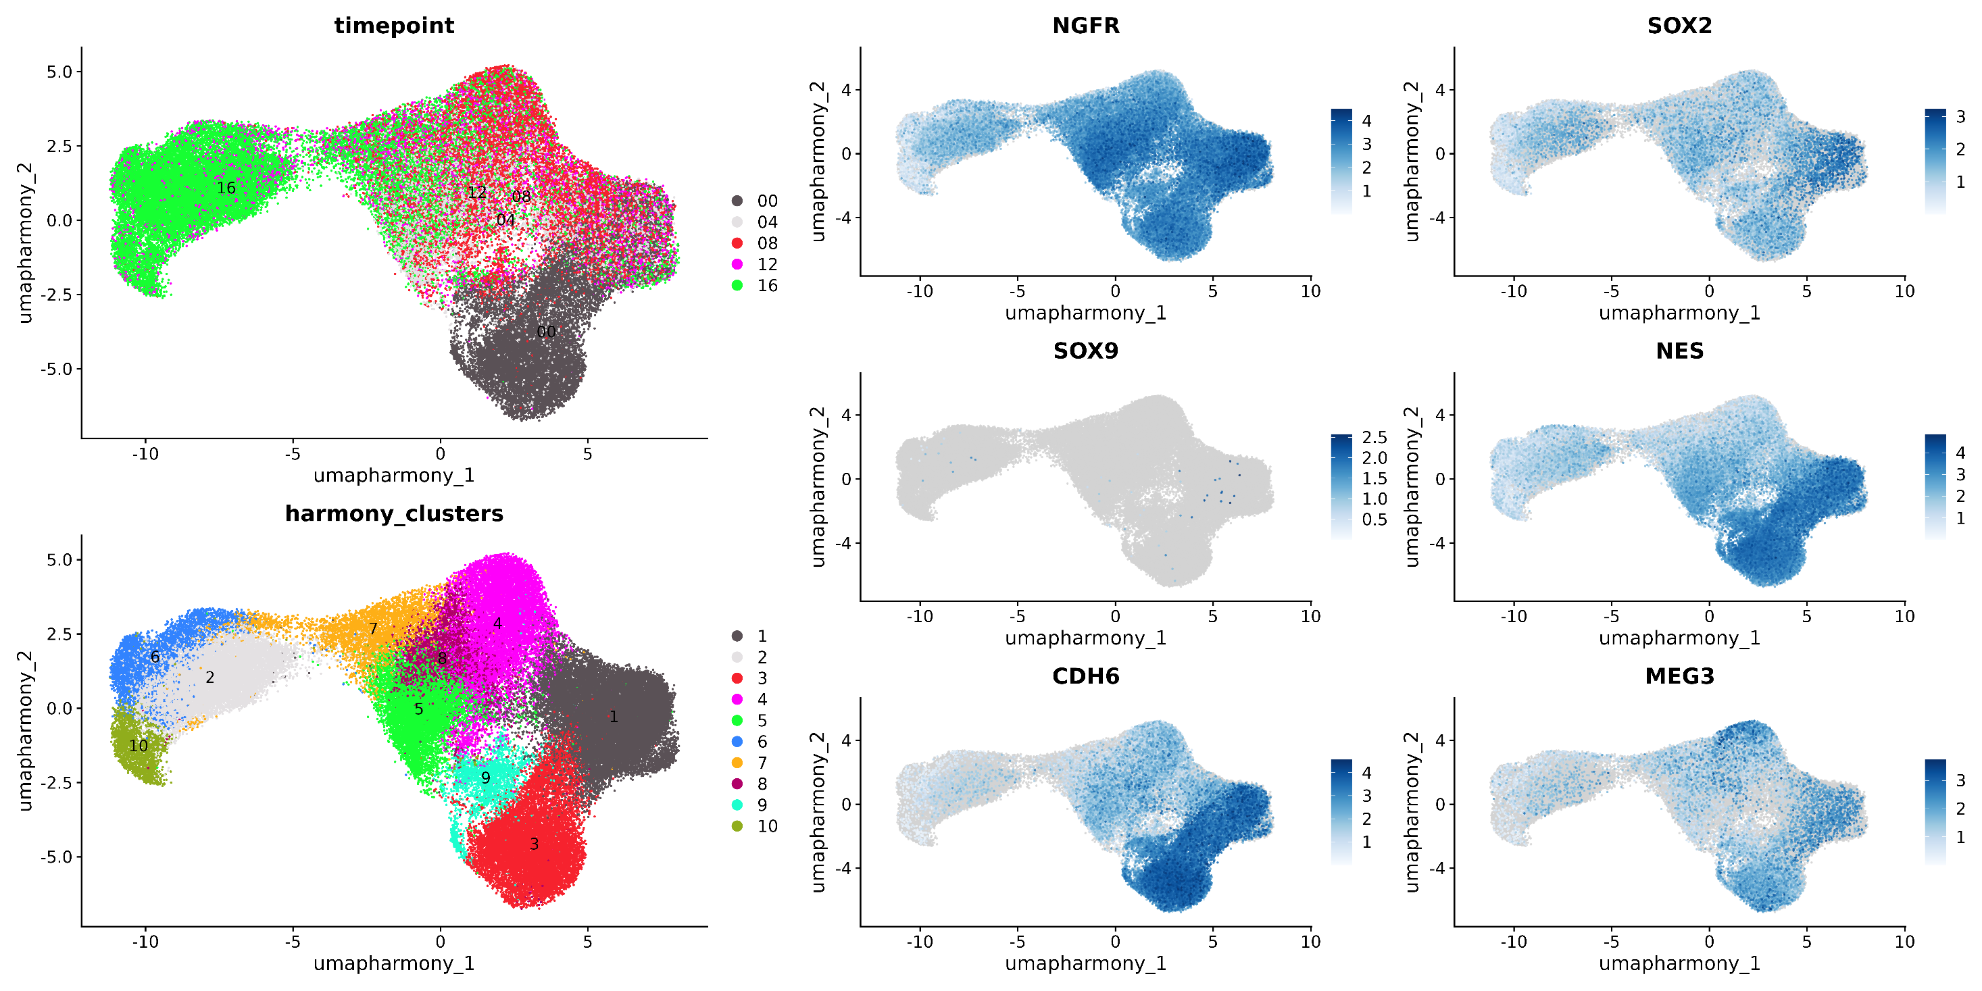

Slide 64
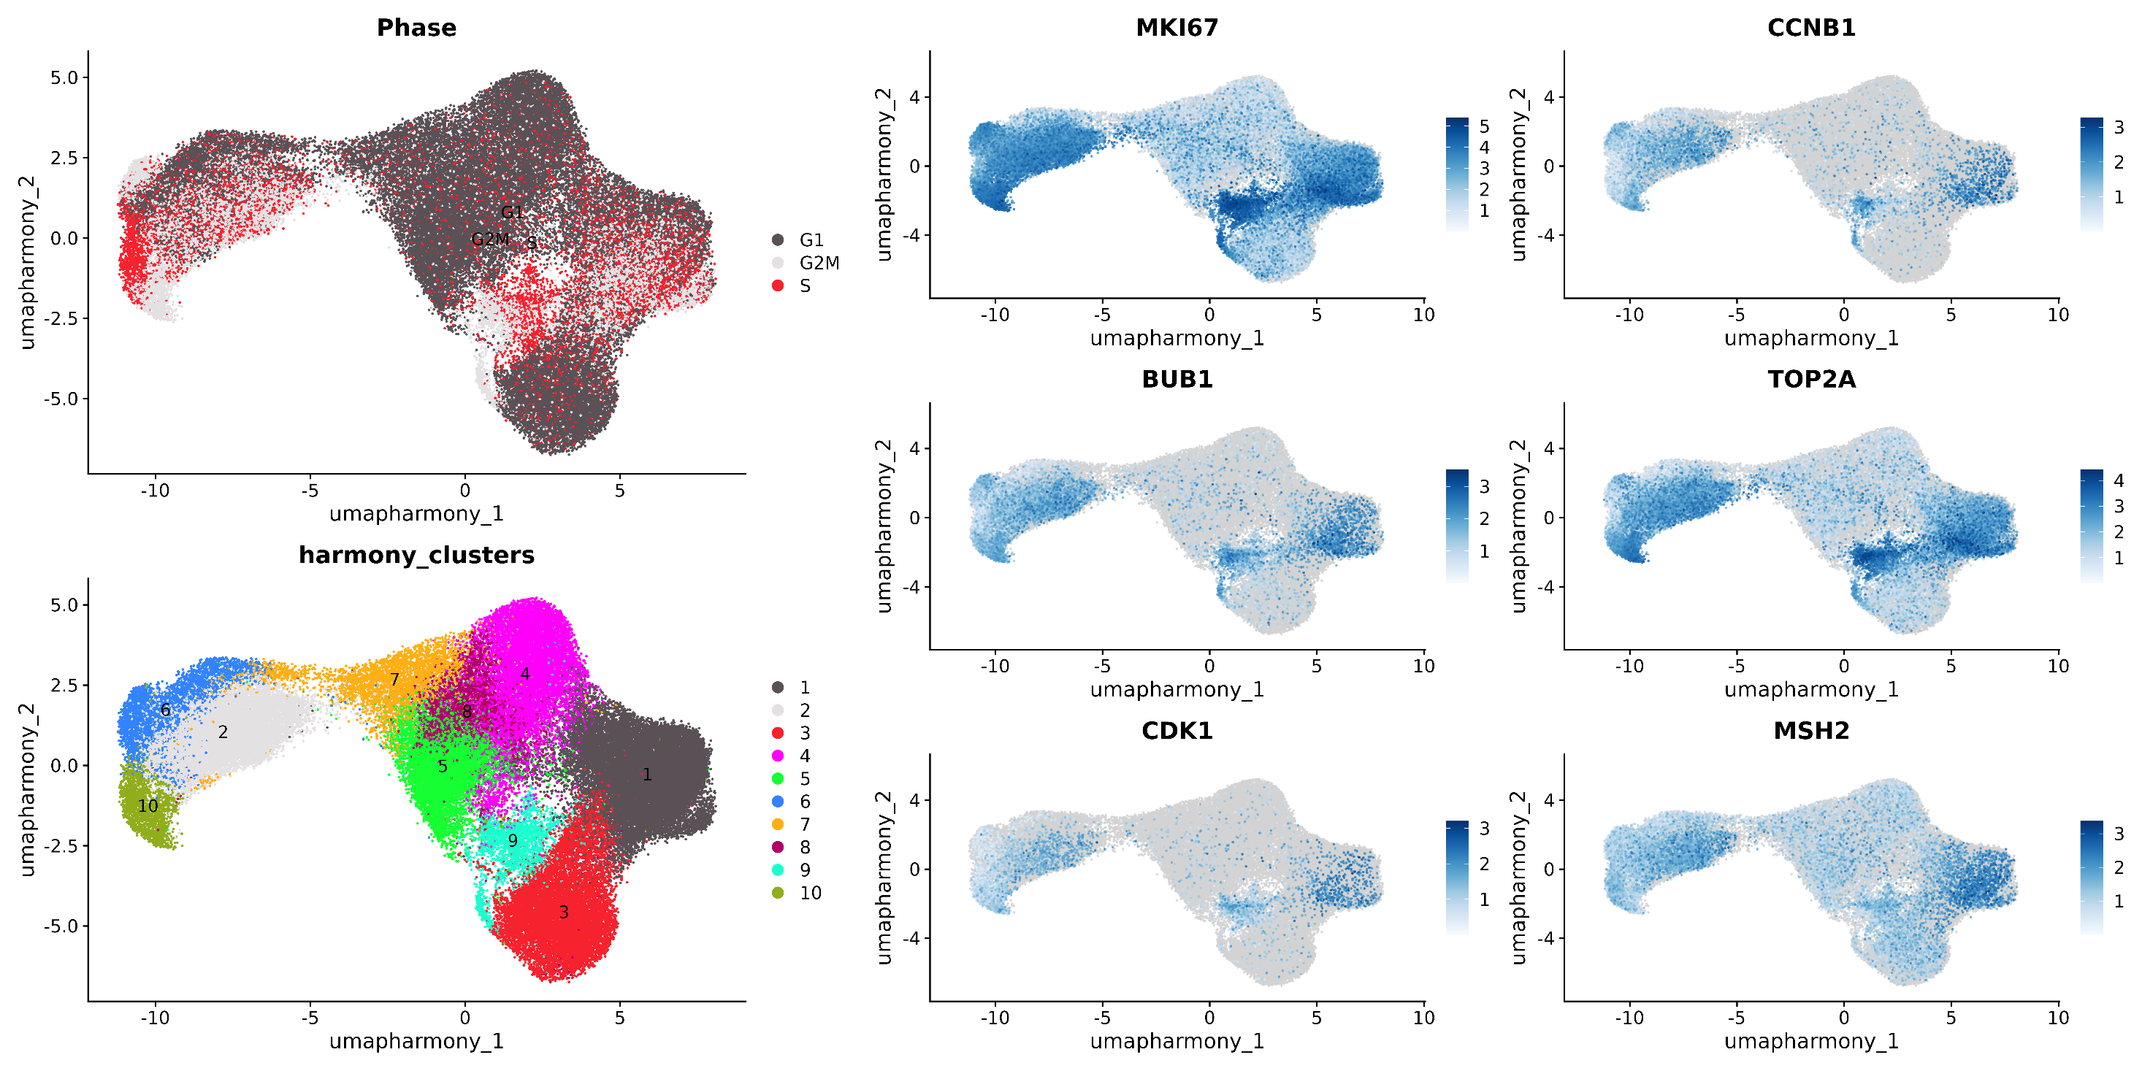
CC genes

Slide 65
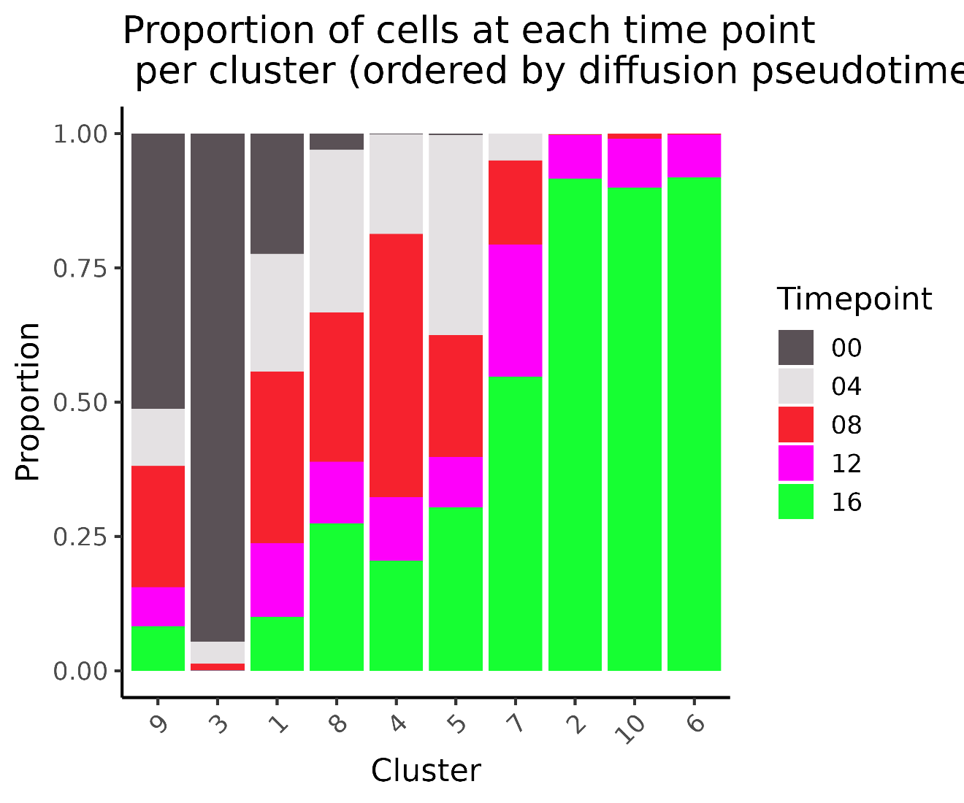

Slide 66
07-Trajectory inference
Pseudotime calculation in diffusion map space
Overall pseudotime with destinys dpt (diffusion pseudotime)
Lineage specific pseudotime with slingshot (in diffusion map space)

Slide 67
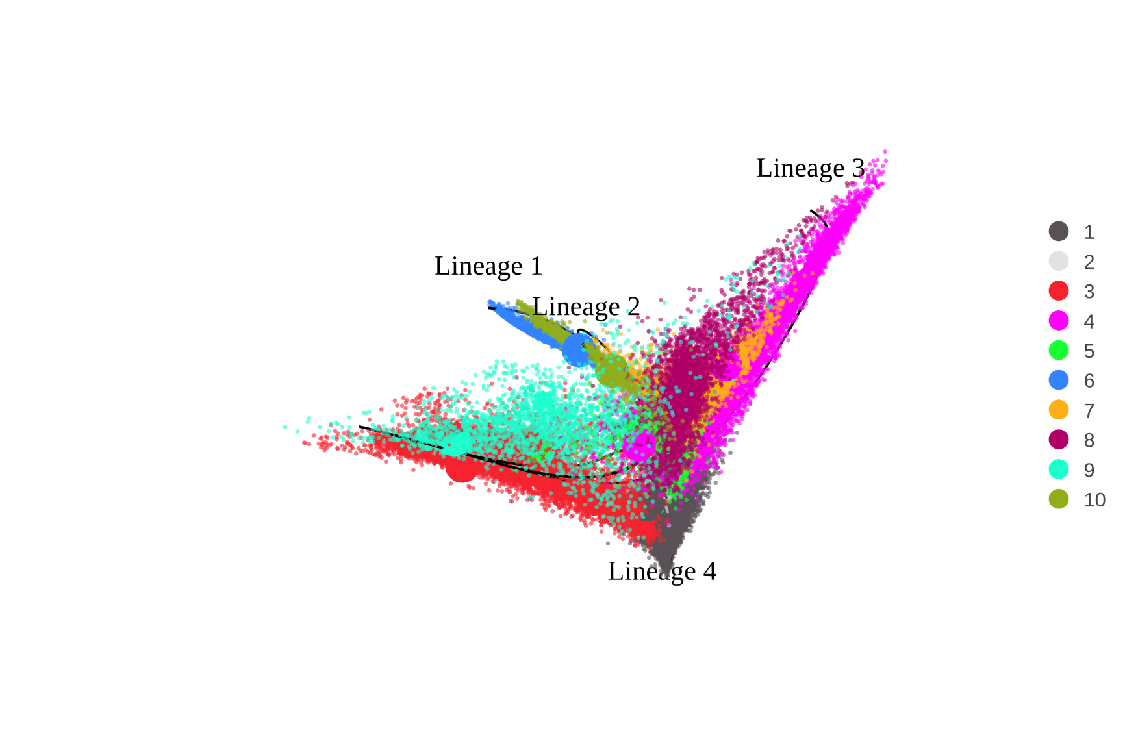






Timepoint
Harmony Clusters
MITF Expression
NGFR Expression
4
3
2
1
0
4
3
2
1
0

Slide 68

Diffusion pseudotime (Destiny)
Slingshot lineages are indicated by black lines. The cells are colored by global diffusion pseudotime

Slide 69



Lineage 1 Slingshot
Lineage 2
Lineage 3
Lineage 4
Slingshot lineages are indicated by black lines. The cells are colored by slingshot lineage specific pseudotime

Slide 70

Monocle3

Slide 71

Pseudotimes per cluster

Slide 72

Correlation of different pseudotime algorithms
*Slingshot consensus pt has been calculated as the lowest pseudotime value for each cell regardless of lineage

Slide 73


Cluster distribution per lineage

Slide 74
07b-CellRank

Slide 75
CellRank
Each path in the high dimensional space get assigned a probability and direction based on the pseudotime. At randomly chosen starting points a random markov chain walk starts. Based on the probabilities several random walks will end at terminal states in different frequencies. These are assigned as fate probabilities.
In easier words it is like a landscape with mountains and valleys. There are several paths, some are easier (more frequented) and some are harder (less frequented). If many persons walk in these valleys and chose random paths based on probability they will end up in certain valleys with a likelihood that reflects this valleys „fate probability“

Slide 76
CellRank to determine cell fates
Trajectory inference and fate probability estimation embeddings To reconstruct cellular trajectories and infer fate probabilities from single-cell RNA sequencing data, we utilized a combination of state-of-the-art computational tools, each leveraging the most appropriate dimensionality reduction for its analytic purpose.
Trajectory inference was performed using Slingshot, destiny, and moscot in diffusion map space. Diffusion maps are well-suited for capturing non-linear, continuous transitions within high-dimensional single-cell datasets, as they emphasize the manifold structure underlying cellular differentiation and development. Specifically, diffusion map coordinates retain information about gradual changes in cellular state, which is essential for accurate pseudotime and lineage reconstruction. Therefore, for all trajectory analyses, including pseudotime estimation and lineage assignment, we computed the k-nearest neighbor graph and performed downstream modeling using the diffusion map embedding.
Cell fate probability estimation was performed using CellRank in principal component analysis (PCA) space. While diffusion maps provide an excellent basis for trajectory inference, we observed substantial numerical instability when using diffusion map coordinates for fate probability calculations in large datasets. In contrast, PCA yields orthogonal components and typically produces a denser, globally well-connected neighbor graph, which is crucial for robust Markov modeling and fate probability computation. Empirically, fate probabilities computed in PCA space were both numerically stable and biologically interpretable, faithfully recapitulating expected lineage decisions and transitions in our data. This choice is consistent with published best practices [1,2] and recommendations from the CellRank development team, which suggest selecting embeddings that maximize both computational robustness and biological interpretability for each analytic step. CellRank GAMS were fitted with the rpy2 implementation of the R package MGCV.
Our approach thus reflects a tailored use of embeddings, leveraging diffusion maps for optimal trajectory reconstruction and PCA for reliable fate probability estimation. By validating the biological plausibility of results in both spaces and prioritizing numerical stability for Markov-based analyses, we ensure that our conclusions about cell state transitions and fate decisions are both methodologically sound and biologically meaningful.
References: 1. Lange, M. et al. CellRank for directed single-cell fate mapping. *Nat Methods* 19, 159–170 (2022). 2. CellRank documentation: https://cellrank.readthedocs.io/en/stable/tutorials.html

Slide 77


Cellrank pseudotime kernel
Neighborhood graph was constructed in PCA space due to denser connected graph. Directionality was calculated based on diffusion pseudotime (Destiny).

Slide 78


Cell fates

Slide 79

Cell fates

Slide 80

Cell fates

Slide 81

Driver genes – Cluster 1
CellRank‘s driver genes are identified by finding the correlation of gene expression with cell fate probabilities. Identified genes are genes which „push“ cells towards a certain fate and therefore can be labelled „drivers“

Slide 82

CellRank drivers – Cluster 1
Top40 CellRank driver genes plotted by pseudotime
If a gene is highly expressed at the timepoint shown here it is associated with the cluster 1 cell fate
NOTE: The order of the genes is based on hierarchical clustering. Similar genes are shown together. The ranking is not from top to bottom. But the top 40 (based on correlation with cell fate) genes are shown.

Slide 83
Function of detected genes
TNC: https://pmc.ncbi.nlm.nih.gov/articles/PMC8526465/
Expression in neural stem/progenitor cells stimulated by EGF and FGF2
ECM protein expressed in proliferative zones of developing nervous system
NES:
Known neural stem cell marker
TGFBI:
Expressed in plethora of stem cells
Top Master Regulator in our bulkRNAseq
THBS1:
A pro geronic factor associated with premature aging and stem cell differentiation: https://www.science.org/doi/10.1126/sciimmunol.ads1556 / https://ashpublications.org/blood/article/140/Supplement%201/1678/487595/Endothelial-mTOR-Preserves-Hematopoietic-Stem-Cell
Associated with TNF/MAPK/NFKB and TGF beta signalling in glioma stem cells: https://pubmed.ncbi.nlm.nih.gov/36935087/
CDH6:
Strong induction in our bulk RNAseq
Expressed in neurogenic progenitors: https://pmc.ncbi.nlm.nih.gov/articles/PMC6916357/
VCAN:
Involved in tumor plasticity (in conjunction with TGFbeta): https://pubmed.ncbi.nlm.nih.gov/24927163/

Slide 84

Driver genes – Cluster 4

Slide 85

CellRank drivers – Cluster 4
Top40 CellRank driver genes plotted by pseudotime
If a gene is highly expressed at the timepoint shown here it is associated with the cluster 4 cell fate

Slide 86
Function of detected genes
COL4A1/2:
Expressed in iPSCs and nervous system https://pubmed.ncbi.nlm.nih.gov/37977146/
Defects lead to epilepsy. It is overexpressed in certain tumors (increased stemness and plasticity): https://jeccr.biomedcentral.com/articles/10.1186/s13046-020-01650-7
LAMC1:
Deletion leads to downregulation of stem cell markers: https://www.sciencedirect.com/science/article/pii/S1534580725004046#bib28
COL5A1 & COL1A2
Expressed in mesenchymal stem cells : https://pmc.ncbi.nlm.nih.gov/articles/PMC6707616/ / https://pmc.ncbi.nlm.nih.gov/articles/PMC4128632/
MATN2: https://pubmed.ncbi.nlm.nih.gov/25329699/
Important for axon regeneration after injury
ECM protein involved in tissue regeneration and stem cell differentiation
ITGA1:
Is linked to cancer stemness: https://www.nature.com/articles/s41598-017-09946-z
Expressed in mesenchymal stem cells: https://pmc.ncbi.nlm.nih.gov/articles/PMC4636027/
KLF9:
Transcriptional regulator of neural stem cell expansion: https://elifesciences.org/articles/72195

Slide 87

Driver genes – Cluster 6

Slide 88

CellRank drivers – Cluster 6
Top40 CellRank driver genes plotted by pseudotime
If a gene is highly expressed at the timepoint shown here it is associated with the cluster 6 cell fate

Slide 89
Function of detected genes
Known markers like MLANA, MET, TRPM1, PMEL
NEAT1:
lncRNA promoting melanoma development and involved in vitiligo: https://pmc.ncbi.nlm.nih.gov/articles/PMC11537649/ / https://www.sciencedirect.com/science/article/pii/S2405580825000032 (through inhibition of miR-23a)
CD44:
Expressed on the entire surface of melanocytes, accumulated at tips of dendrites: https://pubmed.ncbi.nlm.nih.gov/8752662/
MYO10:
Essential for neural crest development and melanoblast migration: https://www.nature.com/articles/s41598-018-28717-y
Also novel potential markers.
PRUNE2:
no role in melanocytes described but important in neuronal processes e.g. Alzheimers: https://www.sciencedirect.com/science/article/abs/pii/S0006899312016058
Tumorsuppressor leading to decreased cell profliferation and invasion and inducing apoptosis https://pmc.ncbi.nlm.nih.gov/articles/PMC8764654/
SOAT1:
Essential for lipid metabolism: https://pmc.ncbi.nlm.nih.gov/articles/PMC11234219/
Lipid metabolism is crucial for melanocyte function to generate melanosomes: https://www.mdpi.com/1422-0067/26/14/6785 / https://pmc.ncbi.nlm.nih.gov/articles/PMC7692067/
MBP (myelin basic protein):
no known function in melanocytes
But involved in neural stem cell proliferation: https://pubmed.ncbi.nlm.nih.gov/27573615/
Important for membrane stability: https://www.pnas.org/doi/10.1073/pnas.0601002103
Important for actin and tubulin transport which might be important for actin dependant transport of melanosomes to dendrites: https://pubmed.ncbi.nlm.nih.gov/16794783/
Interacts with clathrin and might be involved in vesicle trafficking: https://pubmed.ncbi.nlm.nih.gov/16794783/

Slide 90

Driver genes – Cluster 10

Slide 91

CellRank drivers – Cluster 10
Top40 CellRank driver genes plotted by pseudotime
If a gene is highly expressed at the timepoint shown here it is associated with the cluster 10 cell fate

Slide 92
07c-Moscot

Slide 93
Moscot
Moscot uses optimal transport to infer which cells from an earlier timepoint comprise cell populations in a later timepoint
It is a global, deterministic algorithm showing which cells end up and how these transitions have likely been made during temporal space
Diffusion embeddings were exported from R (destiny:DiffusionMap) and imported into python. A new neighborhood graph was calculated and data was used for moscots temporal problem. Afterwards the temporal problem was taken as input for CellRank to test the algorithm with a second underlying scoring metric.
The problem was solved with epsilon = 0.001, scale_cost = „mean“ and max_iterations = 1*10^6

Slide 94

Moscot

Slide 95



Slide 96



Slide 97

Sankey Transitions

Slide 98

Moscot + CellRank with RealTimeKernel
Black dots are starting points of random walks
Yellow dots are likely endpoints of random walks
Data base is the RealTimeKernel of CellRank defining the flow of cells along real time
Cluster 4 as well as 6/10 are identified as „end“ states (Cluster 1 to a lesser degree too)

Slide 99










Data base is the RealTimeKernel of CellRank defining the flow of cells along real time

Slide 100
07d-PAGA
Display of interconnection of clusters based on a knn based graph. Clusters represent nodes and edges are defined by the interconnectivity between clusters. Interconnectivity has been calculated in diffusion map space for denoising as proposed in the PAGA tutorial.

Slide 101

PAGA connectivity graph
Melanocytes mainly develop from intermediate state 7. Cell cycle effects beteen cluster 9 and 10 can be ignored.

Slide 102
08-TradeSeq
Differential expression along trajectory
In the tradeseq vignette it is suggested to use a log2FC cutoff for large cell numbers to reduce false positives→|log2FC| > 1
To account for cell cycle effect, S- and G2/M scores have been regressed out

Slide 103
Lineage 1 Slingshot
Lineage 2
Lineage 3
Lineage 4

Slide 104

GAM model fitting
Number of knots define the flexibility of the model. A higher flexibility allows for smoother curves which reduces variance but increases bias (risk for overfitting). The optimal k was obtained via cross validation and comparing the AIC (lowest AIC is best).

Slide 105
Lineage 1
Melanocyte development

Slide 106



Differences in start and end point – Lineage1

Slide 107



Transiently regulated genes – Lineage1
ITGA1 and MATN2 are just transiently expressed here. In Lineage 3 (Cluster4) CellRank identified them as expressed late and cell fate committing. Factors downregulating these two genes might be important for decision between melanocytes and Cluster4 cells
Genes like
MyoD, myogenin, and p21 may be involved in the negative feedback loop that leads to MATN2 downregulation, as shown in a study on myogenic differentiation where increased levels of these transcription factors in late-stage differentiation result in the repression of MATN2 expression. https://pmc.ncbi.nlm.nih.gov/articles/PMC4498336/
Genes with differential expression patterns (patternTest) but without differential differences between start and end states (startVsEndTest)

Slide 108
Lineage 2
Cycling melanocytes
NOTE: this is not really a lineage as these melanocytes were just different based on cell cycle which does not constitute an own lineage but a cyclical change in gene expression patterns. In order to not dilute the real melanocyte lineage information we did not merge lin1 and lin2.

Slide 109



Differences in start and end point – Lineage2

Slide 110



Transiently regulated genes – Lineage2
Genes with differential expression patterns (patternTest) but without differential differences between start and end states (startVsEndTest)

Slide 111
Lineage 3

Slide 112



Differences in start and end point – Lineage3

Slide 113



Transiently regulated genes – Lineage3
Trio was expressed at a late stage in Lineage 1 and 2. Here it decreases in lineage commitment. TRIO maybe important for melanocyte commitment? Important for neuro-cranial development: https://pmc.ncbi.nlm.nih.gov/articles/PMC7977452/
Here we see the late expression of ITGA1 and MATN2 (complementing the CellRank results)
Genes with differential expression patterns (patternTest) but without differential differences between start and end states (startVsEndTest)

Slide 114
Lineage 4
Melanocyte progenitors/ Extrafollicular melanocyte stem cells / Dermal melanocyte stem cells …

Slide 115



Differences in start and end point – Lineage4

Slide 116



Transiently regulated genes – Lineage4
Trio was expressed at a late stage in Lineage 1 and 2. Here it decreases in lineage commitment. TRIO maybe important for melanocyte commitment?
ITGA1 and MATN2 are also detected in late pseudotimes. Drivers of stemness?
Genes with differential expression patterns (patternTest) but without differential differences between start and end states (startVsEndTest)

Slide 117
Lineage comparisons
Lineage 1 vs Lineage 2
DiffEndTest from TradeSeq package. Tests statistical differences between end states

Slide 118


Slide 119

Top10 higher in lineage 1 than lineage 2
Top10 higher in lineage 2 than lineage 1

Slide 120
Lineage comparisons
Lineage 1 vs Lineage 3

Slide 121


Slide 122

Top10 higher in lineage 1 than lineage 3
Top10 higher in lineage 3 than lineage 1

Slide 123
Function of detected genes
TNC: https://pmc.ncbi.nlm.nih.gov/articles/PMC8526465/
Expression in neural stem/progenitor cells stimulated by EGF and FGF2
ECM protein expressed in proliferative zones of developing nervous system
MATN2: https://pubmed.ncbi.nlm.nih.gov/25329699/
Important for axon regeneration after injury
ECM protein involved in tissue regeneration and stem cell differentiation
NTM: https://www.nature.com/articles/3101842
Cell adhesion molecule involved in the nervous system
KIRREl3: https://pmc.ncbi.nlm.nih.gov/articles/PMC7343328/
Cell adhesion molecule important for neurodevelopment
MEG3: https://pmc.ncbi.nlm.nih.gov/articles/PMC8161278/ / https://pubmed.ncbi.nlm.nih.gov/38613389/
lncRNA which was also detected as one of the most strongly expressed lncRNAs in DSCs (compared to melanocytes)#
Mediates gene expression during stem cell differentiation
MEG8: https://pmc.ncbi.nlm.nih.gov/articles/PMC6254362/
Important for TGF beta induced EMT
Downregulates miR-34a and miR-203 leading to increased SNAI1 and SNAI2 expression
It associates with EZH2 to be guided to the miRNA host genes for transcriptional repression
In conjunction with MEG3 EMT could be activated without TGF beta dependancy (MEG8 or MEG3 alone needed TGF beta signalling to induce EMT)

Slide 124
Lineage comparisons
Lineage 1 vs Lineage 4

Slide 125


Slide 126

Top10 higher in lineage 1 than lineage 4
Top10 higher in lineage 4 than lineage 1

Slide 127
Lineage comparisons
Lineage 3 vs Lineage 4

Slide 128


Slide 129

Top10 higher in lineage 3 than lineage 4
Top10 higher in lineage 4 than lineage 3

Slide 130
09-RNA velocity

Slide 131
RNA velocity
RNA velocity analysis
RNA velocity analysis was performed to infer transcriptional dynamics and potential lineage trajectories. BAM files generated from scRNA-seq alignments were coordinate-sorted and indexed using samtools (vX.X). Spliced and unspliced transcript counts were quantified with velocyto (vX.X) using the command:
velocyto run -b filtered_barcodes.tsv \
-o output_path \
-m repeat_msk_srt.gtf \
sample.bam \
annotation.gtf
where the repeat mask annotation (UCSC RepeatMasker track, hg38) was supplied to exclude repetitive elements (including rRNA, tRNA, and transposable elements) that could confound velocity estimation. This resulted in .loom files containing matrices of spliced, unspliced, and ambiguous transcript counts.
To ensure consistency with the processed Seurat object, cell-level metadata (filtered cell IDs, UMAP embeddings, and clustering assignments) were exported from Seurat (vX.X). The .loom files were imported into anndata and filtered to retain only the cell barcodes present in the Seurat object. Metadata from Seurat (UMAP embeddings, cluster identities, and colors) were then re-integrated into the anndata object to allow velocity estimation in the same embedding space used for clustering and visualization.
Subsequent RNA velocity analysis was performed with scVelo (vX.X). After filtering and normalization, moments were computed across the neighborhood graph, and RNA velocities were estimated using both the stochastic and dynamical models (scv.tl.velocity(mode="stochastic/dynamical")). Velocity graphs were then constructed and projected onto the precomputed Seurat UMAP embedding to visualize transcriptional dynamics and infer putative future states of individual cells.

Slide 132
RNA velocity
RNA velocity is currently debated:
https://genomebiology.biomedcentral.com/articles/10.1186/s13059-023-03065-x
It is unstable based on knn clustering
Especially velocity speed estimates are incorrect
https://www.embopress.org/doi/full/10.15252/msb.202110282
Especially if no continuous timepoints (only distinct timepoints over a long period like in our experimental setup) are supplied
RNA velocity becomes unreliable

Slide 133
10-CellAnnotation

Slide 134
Melanocytes:
Mature melanocyte form 1 cluster
DSC day 0:
Comprised of DSCs, cycling DSCs, melanocyte progenitor cells and fibroblasts
Other clusters:
Induced melanocyte are adjacent to mature melanocyte
There 2-3 unknown transition populations
Based on the previous analyses:
Cluster 3: DSCs
Cluster 9: Cycling DSCs
Cluster 1: Melanogenic-primed cells (MPC)
Cluster 5/8: Transition cells I
Cluster 7: Transition cells II
Cluster 2/6: Melanocytes
Cluster 10: Cycling Melanocytes
Cluster 4: DSC-like reservoir

Slide 135

Melanocytes:
Mature melanocyte form 1 cluster
DSC day 0:
Comprised of DSCs, cycling DSCs, melanocyte progenitor cells and fibroblasts
Other clusters:
Induced melanocyte are adjacent to mature melanocyte
There 2-3 unknown transition populations
Based on the previous analyses:
Cluster 3: DSCs
Cluster 9: Cycling DSCs
Cluster 1: Melanogenic-primed cells (MPC)
Cluster 5/8: Transition cells I
Cluster 7: Transition cells II
Cluster 2/6: Melanocytes
Cluster 10: Cycling Melanocytes
Cluster 4: DSC-like reservoir

Slide 136

Interplay of MATN2 and ITGA1
MATN2 binds to ITGA1 and ITGB1
Interplay with TGF beta/BMP7 signalling: Competing over SMAD4
TGF beta signalling reduces MATN2 signalling
BMP7 enhances MATN2 signalling
Important for ECM signalling pathways
MATN2 is upregulated in melanoma → important for cellular plasticity?
MATN2 is upregulated in early differentiation of muscle cells and downregulated in late stages of differentiation (cell commitment)
→ We see initial upregulation in Cluster 1, In Cluster 4 MATN2 regulation is maintained. The trajectory from Cluster 1 to melanocytes shows downregulation of MATN2
Downregulation might be due to MITF activity: https://pmc.ncbi.nlm.nih.gov/articles/PMC7857731/ (MITF reshapes ECM environment)
We observed an increase in the expression of several integrins including ITGA1, ITGA2, ITGA6, ITGA10, and ITGB3 in the MITF-KO cells, as well as in the siMITF 501Mel and SkMel28 cell lines

Slide 137
Interplay of MATN2 and ITGA1- possible drivers of the stem cell niche in cluster 4
Physical binding / ECM structure: MATN2 integrates into the extracellular matrix, forms adapter networks with collagen and other matrisome proteins, and thereby presents a specific ligand microenvironment for α1β1. This increases local ITGA1 engagement. https://pmc.ncbi.nlm.nih.gov/articles/PMC4498336/?utm_source=chatgpt.com
Integrin signaling stabilizes stemness: ITGA1 binding activates FAK/Src → PI3K/AKT and can interact with TGF-β signaling. These pathways promote cell survival, G1 arrest/quiescence, or a stem-like transcriptional program instead of activating differentiation master regulators (e.g., MITF in melanocytes). https://www.nature.com/articles/s41598-017-09946-z?utm_source=chatgpt.com
Niche / neuronal bias: MATN2 is known in nervous tissue and regenerative niches and can favor neurotrophic / neuronal marker expression — this would explain why MATN2/ITGA1-high cells express neuronal stem markers. https://pmc.ncbi.nlm.nih.gov/articles/PMC4347228/?utm_source=chatgpt.com
In vitro specifics: In vitro this can be reinforced by substrate type, stiffness, medium composition (WNT/TGF/FGF levels), and the absence of the full in vivo stroma/signals — i.e., the cells build a “synthetic niche” locally and remain in the side branch.

Slide 138


Possible regulation of ITGA1/MATN2
ITGA1 and MATN2 were high in DSC-like reservoir cells and melanogenic-primed cells
To find TFs regulating these genes we looked for known interactions between TFs and these targets with TFlink: https://tflink.net/browse/
278 TFs were shown to bind MATN2
357 TFs have predicted interactions with ITGA1
The lists of known regulators were read into R and only common regulators (binding to the promotor of ITGA1 and MATN2 were retained)
194 TFs shared both genes as targets
TFs which were at least 2-fold increased (or decreased) between Melanocytes and DSC-like reservoir cells AND melanogenic-primed cells were retained
Lower in melanocytes
Higher in melanocytes

Slide 139

Annotation of original UMAP (all cells)
Cell labels have been transferred from the previous slide. Fibroblasts were annotated based on their marker gene expression in cluste 6. Epidermal melanocytes were annotated as they were known to be melanocytes

Slide 140

Marker genes for clusters (Top10)
Markers were calcualted with seurat::FindAllMarkers with the options: only.pos = TRUE, logfc.threshold = 0.25, min.pct = 0.1. Only protein-coding genes and lncRNAs were retained as markers. The 10 most significant markers per cluster are shown. If 2 clusters share a marker gene it is only plotted once.

Slide 141



Marker genes for clusters (Top10)
Cycling DSC markers
Cycling melanocyte markers
DSC markers

Slide 142



Marker genes for clusters (Top10)
DSC-like reservoir markers
Epidermal melanocyte markers
Fibroblast markers

Slide 143


Marker genes for clusters (Top10)
Melanocyte markers
Melanogenic primed cell markers

Slide 144


Marker genes for clusters (Top10)
Transitory cell I markers
Transitory cell II markers

Slide 145

Marker genes for clusters (Top20)
Markers were calcualted with seurat::FindAllMarkers with the options: only.pos = TRUE, logfc.threshold = 0.25, min.pct = 0.1. Only protein-coding genes and lncRNAs were retained as markers. The 20 most significant markers per cluster are shown. If 2 clusters share a marker gene it is only plotted once.

Slide 146

GO terms (all markers)

Slide 147

GO terms

Slide 148

GO terms
All stem cell like populations (DSC, DSC-like reservoir, Melanogenic primed cells show elevated expression of MHC complex. https://onlinelibrary.wiley.com/doi/10.1111/pcmr.13169 found a subpopulation of McSC in mice with elevated MHC expression. Conclusion from their analysis: Unlike other stem cells that downregulate MHC-I to avoid immune clearance, C6/C7 (immunogenic subclsuter) show elevated MHC-I expression, validated by bulk RNA-seq. This could make them immunogenic, but expression of PD-L1 (Cd274) likely provides an immune-privileged state by suppressing T cell activity.

Slide 149


Expression of marker genes from the literature
Melanocyte markers
Fibroblast
markers
DSC
markers
Cell cycle
markers

Slide 150


Expression of melanocyte stem cell markers (taken from Yang 2025, citations 42, 43 and 44, Fig. 4)

Slide 151

Expression of melanocyte stem cell markers (taken from Yang 2025, citations 42, 43 and 44, Fig. 4)

Slide 152

Expression of hMEL signature (taken from Yang, Fig. 4)

Slide 153

Number of cells per cluster

Slide 154
11-Comparison with iPSCs (Yang 2025)

Slide 155


Data integration
Without integration
Harmony integration

Slide 156

Melanocyte markers

Slide 157

McSC markers

Slide 158

DSC markers

Slide 159

Fibroblast markers

Slide 160


Expression of marker genes from the literature
Melanocyte markers
Fibroblast
markers
DSC
markers
Cell cycle
markers

Slide 161


Expression of melanocyte stem cell markers (taken from Yang 2025, citations 42, 43 and 44, Fig. 4)

Slide 162
Comparison to Yang 2025 - conclusion
The global structure of the D23, D32 and D44 is more similar to Fibroblasts and melanogenic-cells possibly due to their iPSC origin and their possibility to differentiate into melanocytes (similar to our melanogenic-primed cells)
Based on the marker gene expression of selected markers from the literature they exhibit similarity to our melanocytes
Confirmation that these iPSCs can exhibit melanocyte-like functions but they are transcriptionally much more different to „real“ melanocytes than our differentiated melanocytes originating from DSCs
→ Our model is closer to the real differentiation process?

Slide 163
12-SCENIC

Slide 164
13-CellChat

Slide 165
14-miRScape
Inference of miRNA expression from scRNAseq clusters

